Slide 1
BCS401
Analysis and Design of Algorithms
MODULE 3
P.Kavitha & Dineshkumar K
Assistant Professor
Department of ISE
CMRIT

Slide 2
Module 3 Syllabus
TRANSFORM-AND-CONQUER: Balanced Search Trees, Heaps and Heapsort.
SPACE-TIME TRADEOFFS: Sorting by Counting: Comparison counting sort, Input Enhancement in String Matching: Horspool’s Algorithm.
Chapter 6 (Sections 6.3, 6.4),
Chapter 7 (Sections 7.1, 7.2)

Slide 3
TRANSFORM-AND-CONQUER
There are two stages in this technique:
      Transformation Stage
      Conquering Stage
In Transformation Stage, the problem’s instance is modified to be more amenable solution.
In Conquer Stage, It is solved.

Slide 4
Three Major Variations in this Technique
Instance Simplification: Transformation to a simpler or more convenient instance of the same problem.
Representation Change: Transformation to a different representation of the same instance.
Problem Reduction: Transformation to an instance of a different problem for which an algorithm is already available.
Simpler Instance
OR
Another Representation
OR
Another Problem’s Instance
Problem’s Instance
Problem’s Instance

Slide 5
BALANCED SEARCH TREES
Pre-requisite Knowledge is Binary Search Tree
Binary Search Tree is a Binary Tree in which the value of root node is greater than values of all its left subtree and the value of root node is Less than values of all its right subtree

Slide 6
Construct a BST for the following Array:
45, 51, 32, 58, 53, 35, 76, 48, 18, 12, 54

Slide 7
Construct a BST for the following Array:
45, 51, 32, 58, 53, 35, 76, 48, 18, 12, 54
45

Slide 8
Construct a BST for the following Array:
45, 51, 32, 58, 53, 35, 76, 48, 18, 12, 54
45
51

Slide 9
Construct a BST for the following Array:
45, 51, 32, 58, 53, 35, 76, 48, 18, 12, 54
45
32
51

Slide 10
Construct a BST for the following Array:
45, 51, 32, 58, 53, 35, 76, 48, 18, 12, 54
45
32
51
58

Slide 11
Construct a BST for the following Array:
45, 51, 32, 58, 53, 35, 76, 48, 18, 12, 54
45
32
51
58
53

Slide 12
Construct a BST for the following Array:
45, 51, 32, 58, 53, 35, 76, 48, 18, 12, 54
45
32
51
35
58
53

Slide 13
Construct a BST for the following Array:
45, 51, 32, 58, 53, 35, 76, 48, 18, 12, 54
45
32
51
35
58
53
76

Slide 14
Construct a BST for the following Array:
45, 51, 32, 58, 53, 35, 76, 48, 18, 12, 54
45
32
51
35
48
58
53
76

Slide 15
Construct a BST for the following Array:
45, 51, 32, 58, 53, 35, 76, 48, 18, 12, 54
45
32
51
18
35
48
58
53
76

Slide 16
Construct a BST for the following Array:
45, 51, 32, 58, 53, 35, 76, 48, 18, 12, 54
45
32
51
18
35
48
58
12
53
76

Slide 17
Construct a BST for the following Array:
45, 51, 32, 58, 53, 35, 76, 48, 18, 12, 54
45
32
51
18
35
48
58
12
53
76
54

Slide 18
BALANCED SEARCH TREES
Two Approaches:
  Instance Simplification Variety: An unbalanced Binary Search Tree is transformed into a balanced one. Such Trees are called as Self Balancing.
      An AVL Tree requires the difference between the heights of the left and right subtrees of every node never exceed 1.
      Red-Black Tree tolerates the height of one subtree being twice as large as the other subtree of the same node.
  Representation Change variety: Allows more than one element in a node of a search tree.
      2-3 Trees and 2-3-4 Trees and B-Trees. They differ in the number of elements admissible in a single node of a search tree, but all are perfectly balanced.

Slide 19
AVL TREES
An AVL Tree is a Binary Search Tree in which the balance factor of every node, which is defined as the difference between the heights of the node’s left and right subtrees, is either 0, or +1, or –1 (Height of an empty Tree is defined as –1). The Balance factor can be computed as the difference between number of levels rather than height difference of node’s left and right subtrees.

Slide 20
Rotations in AVL Tree Construction
A Rotation in an AVL tree is a local a local transformation of its subtree routed at a node whose balance has become either +2 or –2. Rotate the tree at the unbalanced node that is closest to the newly inserted leaf.

Slide 21
Different Types of the Rotations in AVL Tree
Four types of Rotation in AVL Tree:
        R – Rotation (Single Right Rotation)
        L – Rotation (Single Left Rotation)
        LR – Rotation (Double Left Right Rotation)
        RL – Rotation (Double Right Left Rotation)

Slide 22
Single Right Rotation
When a new key is inserted at the left subtree of the left child of a tree whose root had balance factor of +1 before insertion, then R-Rotation is performed
2–0 = 2
3
2
1–1 = 0
R
1–0 = 1
2
0
0
1
3
0
1

Slide 23
Single Right Rotation
When a new key is inserted at the left subtree of the left child of a tree whose root had balance factor of +1 before insertion, then R-Rotation is performed
r
c
R
c
T3
T1
r
T1
T2
T2
T3

Slide 24
Single Left Rotation
When a new key is inserted at the right subtree of the right child of a tree whose root had balance factor of –1 before insertion, then L-Rotation is performed
1
2–0 = 2
2
1–1 = 0
L
2
0
0
1–0 = 1
1
3
0
3

Slide 25
Double Left-Right Rotation
It is a combination of two rotations: Perform the L-Rotation of the left subtree of root r followed by the R-Rotation of the new tree rooted at r. It is performed when a new node is inserted at the right subtree of the left child of a tree.
3
2–0 = 2
3
2–0=2
2
1–1=0
R
L
0–1=–1
0–1=–1
2
0
0
1
1
3
0
0
2
1

Slide 26
Double Left-Right Rotation
It is a combination of two rotations: Perform the L-Rotation of the left subtree of root r followed by the R-Rotation of the new tree rooted at r. It is performed when a new node is inserted at the right subtree of the left child of a tree.
r
g
c
T4
LR
c
r
T1
T2
T3
T4
T1
g
Or
T2
T3
Or

Slide 27
Double Right-Left Rotation
It is a combination of two rotations: Perform the R-Rotation of the right subtree of root r followed by the L-Rotation of the new tree rooted at r. It is performed when a new node is inserted at the left subtree of the right child of a tree.
1
0–2=–2
1
0–2=–2
2
1–1=0
L
R
0–1=–1
2
0
0
1–0=1
3
1
3
3
2
0
0

Slide 28
Example: Construct AVL Tree for the given Array:
14, 17, 11, 7, 53, 4, 13, 12, 8, 60, 19, 16, 20

Slide 29
Example: Construct AVL Tree for the given Array:
14, 17, 11, 7, 53, 4, 13, 12, 8, 60, 19, 16, 20
0
14
Insert the node 14 into the root. Its Balance factor is 0

Slide 30
Example: Construct AVL Tree for the given Array:
14, 17, 11, 7, 53, 4, 13, 12, 8, 60, 19, 16, 20
14
17
Since 17 > 14, insert 17 in Right of 14

Slide 31
Example: Construct AVL Tree for the given Array:
14, 17, 11, 7, 53, 4, 13, 12, 8, 60, 19, 16, 20
14
–1
Since 17 > 14, insert 17 in Right of 14
The Balance factor of node 17 is 0,
The Balance factor of node 14 is 0 – 1 = –1
0
17

Slide 32
Example: Construct AVL Tree for the given Array:
14, 17, 11, 7, 53, 4, 13, 12, 8, 60, 19, 16, 20
14
–1
The Balance factor of node 17 is 0,
The Balance factor of node 14 is 0 – 1 = –1
0
17

Slide 33
Example: Construct AVL Tree for the given Array:
14, 17, 11, 7, 53, 4, 13, 12, 8, 60, 19, 16, 20
14
Insert 11 to left of 14 Since 11 < 14.
11
17

Slide 34
Example: Construct AVL Tree for the given Array:
14, 17, 11, 7, 53, 4, 13, 12, 8, 60, 19, 16, 20
14
0
Insert 11 to left of 14 Since 11 < 14.
Balance Factor of the node 11 is 0,
Balance Factor of the node 17 is 0,
Balance Factor of the node 14 is 1 – 1 = 0,
0
0
11
17

Slide 35
Example: Construct AVL Tree for the given Array:
14, 17, 11, 7, 53, 4, 13, 12, 8, 60, 19, 16, 20
14
Insert 7 to left of 11 Since 7 < 11.
11
17
7

Slide 36
Example: Construct AVL Tree for the given Array:
14, 17, 11, 7, 53, 4, 13, 12, 8, 60, 19, 16, 20
1
14
Insert 7 to left of 11 Since 7 < 11.
Balance Factor of the node 7 is 0,
Balance Factor of the node 11 is 1 – 0 = 1,
Balance Factor of the node 17 is 0,
Balance Factor of the node 14 is 2 – 1 = 1,
1
0
11
17
0
7

Slide 37
Example: Construct AVL Tree for the given Array:
14, 17, 11, 7, 53, 4, 13, 12, 8, 60, 19, 16, 20
14
Insert 53 to right of 17 Since 53 > 17.
11
17
7
53

Slide 38
Example: Construct AVL Tree for the given Array:
14, 17, 11, 7, 53, 4, 13, 12, 8, 60, 19, 16, 20
0
14
Insert 53 to right of 17 Since 53 > 17.
Balance Factor of the node 7 is 0,
Balance Factor of the node 53 is 0,
Balance Factor of the node 11 is 1 – 0 = 1,
Balance Factor of the node 17 is 0 – 1 = –1,
Balance Factor of the node 14 is 2 – 2 = 0,
1
–1
11
17
0
0
7
53

Slide 39
Example: Construct AVL Tree for the given Array:
14, 17, 11, 7, 53, 4, 13, 12, 8, 60, 19, 16, 20
14
Insert 4 to left of 7 Since 4 < 7.
11
17
7
53
4

Slide 40
Example: Construct AVL Tree for the given Array:
14, 17, 11, 7, 53, 4, 13, 12, 8, 60, 19, 16, 20
14
Insert 4 to left of 7 Since 4 < 7.
Balance Factor of the node 4 is 0,
Balance Factor of the node 7 is 1 – 0 = 1,
Balance Factor of the node 53 is 0,
Balance Factor of the node 17 is 0 – 1 = –1, Balance Factor of the node 11 is 2 – 0 = 2,
2
–1
11
17
1
0
7
53
0
4

Slide 41
Example: Construct AVL Tree for the given Array:
14, 17, 11, 7, 53, 4, 13, 12, 8, 60, 19, 16, 20
14
Insert 4 to left of 7 Since 4 < 7.
Balance Factor of the node 4 is 0,
Balance Factor of the node 7 is 1 – 0 = 1,
Balance Factor of the node 53 is 0,
Balance Factor of the node 17 is 0 – 1 = –1, Balance Factor of the node 11 is 2 – 0 = 2,
Node 11 is not balanced. So, Rotate 4, 7, 11
2
–1
11
17
1
0
7
53
0
4

Slide 42
Example: Construct AVL Tree for the given Array:
14, 17, 11, 7, 53, 4, 13, 12, 8, 60, 19, 16, 20
14
Insert 4 to left of 7 Since 4 < 7.
Balance Factor of the node 4 is 0,
Balance Factor of the node 7 is 1 – 0 = 1,
Balance Factor of the node 53 is 0,
Balance Factor of the node 17 is 0 – 1 = –1, Balance Factor of the node 11 is 2 – 0 = 2,
Node 11 is not balanced. So, Rotate 4, 7, 11
After 11 in this path, we have insertion LL,
We need to perform Right Rotation
Since node 7 is middle node, it will be root.
Left of 7 is node 4 and right of 7 is node 11
2
–1
11
17
1
0
7
53
0
4

Slide 43
Example: Construct AVL Tree for the given Array:
14, 17, 11, 7, 53, 4, 13, 12, 8, 60, 19, 16, 20
0
14
Now the Balance Factors are
Balance Factor of the node 4 is 0,
Balance Factor of the node 11 is 0,
Balance Factor of the node 53 is 0,
Balance Factor of the node 7 is 1 – 1 = 0,
Balance Factor of the node 17 is 0 – 1 = –1, Balance Factor of the node 14 is 2 – 2 = 0
0
–1
7
17
0
0
0
4
11
53

Slide 44
Example: Construct AVL Tree for the given Array:
14, 17, 11, 7, 53, 4, 13, 12, 8, 60, 19, 16, 20
14
Now Insert Node 13 to right of 11
7
17
4
11
53
13

Slide 45
Example: Construct AVL Tree for the given Array:
14, 17, 11, 7, 53, 4, 13, 12, 8, 60, 19, 16, 20
1
14
Now Insert Node 13 to right of 11
Balance Factor of the node 13 is 0,
Balance Factor of the node 4 is 0,
Balance Factor of the node 11 is 0 – 1 = –1,
Balance Factor of the node 53 is 0,
Balance Factor of the node 7 is 1 – 2 = –1,
Balance Factor of the node 17 is 0 – 1 = –1, Balance Factor of the node 14 is 3 – 2 = 1
–1
–1
7
17
0
–1
0
4
11
53
0
13

Slide 46
Example: Construct AVL Tree for the given Array:
14, 17, 11, 7, 53, 4, 13, 12, 8, 60, 19, 16, 20
14
Now Insert Node 12 to left of 13
7
17
4
11
53
13
12

Slide 47
Example: Construct AVL Tree for the given Array:
14, 17, 11, 7, 53, 4, 13, 12, 8, 60, 19, 16, 20
14
Now Insert Node 12 to left of 13
Balance Factor of the node 12 is 0,
Balance Factor of the node 13 is 1 – 0 = 1,
Balance Factor of the node 4 is 0,
Balance Factor of the node 11 is 0 – 2 = –2,
Balance Factor of the node 53 is 0,
Balance Factor of the node 17 is 0 – 1 = –1
–1
7
17
0
–2
0
4
11
53
1
13
0
12

Slide 48
Example: Construct AVL Tree for the given Array:
14, 17, 11, 7, 53, 4, 13, 12, 8, 60, 19, 16, 20
14
Now Insert Node 12 to left of 13
Balance Factor of the node 12 is 0,
Balance Factor of the node 13 is 1 – 0 = 1,
Balance Factor of the node 4 is 0,
Balance Factor of the node 11 is 0 – 2 = –2,
Balance Factor of the node 53 is 0,
Balance Factor of the node 17 is 0 – 1 = –1
Node 11 is not Balanced.
–1
7
17
0
–2
0
4
11
53
1
13
0
12

Slide 49
Example: Construct AVL Tree for the given Array:
14, 17, 11, 7, 53, 4, 13, 12, 8, 60, 19, 16, 20
14
Now Insert Node 12 to left of 13
Balance Factor of the node 12 is 0,
Balance Factor of the node 13 is 1 – 0 = 1,
Balance Factor of the node 4 is 0,
Balance Factor of the node 11 is 0 – 2 = –2,
Balance Factor of the node 53 is 0,
Balance Factor of the node 17 is 0 – 1 = –1
Node 11 is not Balanced.
In the sequence of nodes 11, 12, 13 the middle node is 12. So, it will be the root.
–1
7
17
0
–2
0
4
11
53
1
13
0
12

Slide 50
Example: Construct AVL Tree for the given Array:
14, 17, 11, 7, 53, 4, 13, 12, 8, 60, 19, 16, 20
14
Now Insert Node 12 to left of 13
Balance Factor of the node 12 is 0,
Balance Factor of the node 13 is 1 – 0 = 1,
Balance Factor of the node 4 is 0,
Balance Factor of the node 11 is 0 – 2 = –2,
Balance Factor of the node 53 is 0,
Balance Factor of the node 17 is 0 – 1 = –1
Node 11 is not Balanced.
In the sequence of nodes 11, 12, 13 the middle node is 12. So, it will be the root.
Left of 12 is node 11 and Right of 12 is 13
7
17
4
12
53
11
13

Slide 51
Example: Construct AVL Tree for the given Array:
14, 17, 11, 7, 53, 4, 13, 12, 8, 60, 19, 16, 20
14
1
Now the Balance Factors of nodes are:
Balance Factor of the node 11 is 0,
Balance Factor of the node 13 is 0,
Balance Factor of the node 4 is 0,
Balance Factor of the node 12 is 1 – 1 = 0,
Balance Factor of the node 53 is 0,
Balance Factor of the node 17 is 0 – 1 = –1
Balance Factor of the node 7 is 1 – 2 = –1
Balance Factor of the node 14 is 3 – 2 = 1
–1
7
–1
17
0
0
0
4
12
53
0
0
11
13

Slide 52
Example: Construct AVL Tree for the given Array:
14, 17, 11, 7, 53, 4, 13, 12, 8, 60, 19, 16, 20
14
Now the insert node 8 to left of 11
7
17
4
12
53
11
13
8

Slide 53
Example: Construct AVL Tree for the given Array:
14, 17, 11, 7, 53, 4, 13, 12, 8, 60, 19, 16, 20
14
Now the insert node 8 to left of 11
Balance Factor of the node 8 is 0,
Balance Factor of the node 11 is 1 – 0 = 1,
Balance Factor of the node 13 is 0,
Balance Factor of the node 4 is 0,
Balance Factor of the node 12 is 2 – 1 = 1,
Balance Factor of the node 53 is 0,
Balance Factor of the node 17 is 0 – 1 = –1
Balance Factor of the node 7 is 1 – 3 = –2
–1
7
–2
17
0
1
0
4
12
53
0
1
11
13
0
8

Slide 54
Example: Construct AVL Tree for the given Array:
14, 17, 11, 7, 53, 4, 13, 12, 8, 60, 19, 16, 20
14
Now the insert node 8 to left of 11
Balance Factor of the node 8 is 0,
Balance Factor of the node 11 is 1 – 0 = 1,
Balance Factor of the node 13 is 0,
Balance Factor of the node 4 is 0,
Balance Factor of the node 12 is 2 – 1 = 1,
Balance Factor of the node 53 is 0,
Balance Factor of the node 17 is 0 – 1 = –1
Balance Factor of the node 7 is 1 – 3 = –2
Node 7 is now Unbalanced, So Balance it.
–1
7
–2
17
0
1
0
4
12
53
0
1
11
13
0
8

Slide 55
Example: Construct AVL Tree for the given Array:
14, 17, 11, 7, 53, 4, 13, 12, 8, 60, 19, 16, 20
14
Consider the Sequence of nodes 7, 11, 12
The middle node is 11 and it will be the root.
Left of 11 is node 7 and Right of 11 is node 12
–1
7
–2
17
0
1
0
4
12
53
0
1
11
13
0
8

Slide 56
Example: Construct AVL Tree for the given Array:
14, 17, 11, 7, 53, 4, 13, 12, 8, 60, 19, 16, 20
14
Consider the Sequence of nodes 7, 11, 12
The middle node is 11 and it will be the root.
Left of 11 is node 7 and Right of 11 is node 12
Right of 7 will be the node 8
11
17
7
12
53
4
13
8

Slide 57
Example: Construct AVL Tree for the given Array:
14, 17, 11, 7, 53, 4, 13, 12, 8, 60, 19, 16, 20
14
Consider the Sequence of nodes 7, 11, 12
The middle node is 11 and it will be the root.
Left of 11 is node 7 and Right of 11 is node 12
Right of 7 will be the node 8
11
17
7
12
53
4
8
13

Slide 58
Example: Construct AVL Tree for the given Array:
14, 17, 11, 7, 53, 4, 13, 12, 8, 60, 19, 16, 20
14
1
Balance Factor of all the node are:
Balance Factor of node 4 is 0
Balance Factor of node 8 is 0
Balance Factor of node 13 is 0
Balance Factor of node 53 is 0
Balance Factor of node 7 is 1 – 1 = 0
Balance Factor of node 12 is 0 – 1 = –1
Balance Factor of node 11 is 2 – 2 = 0
Balance Factor of node 17 is 0 – 1 = –1
Balance Factor of node 14 is 3 – 2 = 1
–1
11
0
17
0
–1
0
7
12
53
0
0
0
4
8
13

Slide 59
Example: Construct AVL Tree for the given Array:
14, 17, 11, 7, 53, 4, 13, 12, 8, 60, 19, 16, 20
14
Now Insert the node 60 to right of 53
11
17
7
12
53
4
8
13
60

Slide 60
Example: Construct AVL Tree for the given Array:
14, 17, 11, 7, 53, 4, 13, 12, 8, 60, 19, 16, 20
14
Now Insert the node 60 to right of 53
Balance Factor of node 4 is 0
Balance Factor of node 8 is 0
Balance Factor of node 13 is 0
Balance Factor of node 53 is 0 – 1 = –1
Balance Factor of node 7 is 1 – 1 = 0
Balance Factor of node 12 is 0 – 1 = –1
Balance Factor of node 11 is 2 – 2 = 0
Balance Factor of node 17 is 0 – 2 = –2
Node 17 is Unbalanced.
–2
11
0
17
0
–1
–1
7
12
53
0
0
0
0
4
8
13
60

Slide 61
Example: Construct AVL Tree for the given Array:
14, 17, 11, 7, 53, 4, 13, 12, 8, 60, 19, 16, 20
14
Now Insert the node 60 to right of 53
Balance Factor of node 4 is 0
Balance Factor of node 8 is 0
Balance Factor of node 13 is 0
Balance Factor of node 53 is 0 – 1 = –1
Balance Factor of node 7 is 1 – 1 = 0
Balance Factor of node 12 is 0 – 1 = –1
Balance Factor of node 11 is 2 – 2 = 0
Balance Factor of node 17 is 0 – 2 = –2
Node 17 is Unbalanced.
–2
11
0
17
0
–1
–1
7
12
53
0
0
0
0
4
8
13
60

Slide 62
Example: Construct AVL Tree for the given Array:
14, 17, 11, 7, 53, 4, 13, 12, 8, 60, 19, 16, 20
14
In the sequence of nodes 17, 53, 60
The middle node is 53, It is the root.
–2
11
0
17
0
–1
–1
7
12
53
0
0
0
0
4
8
13
60

Slide 63
Example: Construct AVL Tree for the given Array:
14, 17, 11, 7, 53, 4, 13, 12, 8, 60, 19, 16, 20
14
In the sequence of nodes 17, 53, 60
The middle node is 53, It is the root.
Left of 53 is 17 and Right of 53 is 60
11
53
7
12
17
60
4
8
13

Slide 64
Example: Construct AVL Tree for the given Array:
14, 17, 11, 7, 53, 4, 13, 12, 8, 60, 19, 16, 20
14
1
Balance Factor of node 4 is 0
Balance Factor of node 8 is 0
Balance Factor of node 13 is 0
Balance Factor of node 7 is 1 – 1 = 0
Balance Factor of node 12 is 0 – 1 = –1
Balance Factor of node 17 is 0
Balance Factor of node 60 is 0
Balance Factor of node 11 is 2 – 2 = 0
Balance Factor of node 53 is 1 – 1 = 0
Balance Factor of node 14 is 3 – 2 = 1
0
11
0
53
0
–1
0
0
7
12
17
60
0
0
0
4
8
13

Slide 65
Example: Construct AVL Tree for the given Array:
14, 17, 11, 7, 53, 4, 13, 12, 8, 60, 19, 16, 20
14
Now insert 19 to right of 17
53
11
17
60
7
12
8
13
19
4

Slide 66
Example: Construct AVL Tree for the given Array:
14, 17, 11, 7, 53, 4, 13, 12, 8, 60, 19, 16, 20
14
0
Now insert 19 to right of 17
Balance Factor of node 4 is 0
Balance Factor of node 8 is 0
Balance Factor of node 13 is 0
Balance Factor of node 19 is 0
Balance Factor of node 7 is 1 – 1 = 0
Balance Factor of node 12 is 0 – 1 = –1
Balance Factor of node 17 is 0 – 1 = –1
Balance Factor of node 60 is 0
Balance Factor of node 11 is 2 – 2 = 0
Balance Factor of node 53 is 2 – 1 = 1
Balance Factor of node 14 is 3 – 3 = 0
1
0
53
11
0
–1
–1
0
17
60
7
12
0
0
0
13
19
0
4
8

Slide 67
Example: Construct AVL Tree for the given Array:
14, 17, 11, 7, 53, 4, 13, 12, 8, 60, 19, 16, 20
14
Now insert 16 to left of 17
53
11
17
60
7
12
8
13
16
19
4

Slide 68
Example: Construct AVL Tree for the given Array:
14, 17, 11, 7, 53, 4, 13, 12, 8, 60, 19, 16, 20
14
0
Now insert 16 to left of 17
Balance Factor of node 4 is 0
Balance Factor of node 8 is 0
Balance Factor of node 13 is 0
Balance Factor of node 16 is 0
Balance Factor of node 19 is 0
Balance Factor of node 7 is 1 – 1 = 0
Balance Factor of node 12 is 0 – 1 = –1
Balance Factor of node 17 is 1 – 1 = 0
Balance Factor of node 60 is 0
Balance Factor of node 11 is 2 – 2 = 0
Balance Factor of node 53 is 2 – 1 = 1
Balance Factor of node 14 is 3 – 3 = 0
1
0
53
11
0
0
0
–1
17
60
7
12
0
0
0
0
19
0
4
8
13
16

Slide 69
Example: Construct AVL Tree for the given Array:
14, 17, 11, 7, 53, 4, 13, 12, 8, 60, 19, 16, 20
14
Now insert 20 to left of 19
53
11
17
60
7
12
8
13
16
19
4
20

Slide 70
Example: Construct AVL Tree for the given Array:
14, 17, 11, 7, 53, 4, 13, 12, 8, 60, 19, 16, 20
Now insert 20 to left of 19
Balance Factor of node 4 is 0
Balance Factor of node 8 is 0
Balance Factor of node 13 is 0
Balance Factor of node 16 is 0
Balance Factor of node 20 is 0
Balance Factor of node 19 is 0 – 1 = –1
Balance Factor of node 7 is 1 – 1 = 0
Balance Factor of node 12 is 0 – 1 = –1
Balance Factor of node 17 is 1 – 2 = –1
Balance Factor of node 60 is 0
Balance Factor of node 11 is 2 – 2 = 0
Balance Factor of node 53 is 3 – 1 = 2
Node 53 is Unbalanced.
14
2
0
53
11
–1
0
0
–1
17
60
7
12
0
0
0
0
19
–1
4
8
13
16
0
20

Slide 71
Example: Construct AVL Tree for the given Array:
14, 17, 11, 7, 53, 4, 13, 12, 8, 60, 19, 16, 20
Now insert 20 to left of 19
Balance Factor of node 4 is 0
Balance Factor of node 8 is 0
Balance Factor of node 13 is 0
Balance Factor of node 16 is 0
Balance Factor of node 20 is 0
Balance Factor of node 19 is 0 – 1 = –1
Balance Factor of node 7 is 1 – 1 = 0
Balance Factor of node 12 is 0 – 1 = –1
Balance Factor of node 17 is 1 – 2 = –1
Balance Factor of node 60 is 0
Balance Factor of node 11 is 2 – 2 = 0
Balance Factor of node 53 is 3 – 1 = 2
Node 53 is Unbalanced.
14
2
0
53
11
–1
0
0
–1
17
60
7
12
0
0
0
0
19
–1
4
8
13
16
0
20

Slide 72
Example: Construct AVL Tree for the given Array:
14, 17, 11, 7, 53, 4, 13, 12, 8, 60, 19, 16, 20
14
Consider the node sequence 17, 19, 53
The middle node is 19. It is the root.
2
0
53
11
–1
0
0
–1
17
60
7
12
0
0
0
0
19
–1
4
8
13
16
0
20

Slide 73
Example: Construct AVL Tree for the given Array:
14, 17, 11, 7, 53, 4, 13, 12, 8, 60, 19, 16, 20
14
In the node sequence 17, 19, 53
The middle node is 19. It is the root.
Left of 19 is node 17 and Right of 19 is the node 53.
The node 20 should be to right of 19. But Right of 19 is already filled with the node 53. So, Left of 53 is 19.
19
11
17
53
7
12
4
8
13
16
20
60

Slide 74
Example: Construct AVL Tree for the given Array:
14, 17, 11, 7, 53, 4, 13, 12, 8, 60, 19, 16, 20
14
0
Balance Factor of node 4 is 0
Balance Factor of node 8 is 0
Balance Factor of node 13 is 0
Balance Factor of node 16 is 0
Balance Factor of node 20 is 0
Balance Factor of node 60 is 0
Balance Factor of node 19 is 0 – 1 = –1
Balance Factor of node 7 is 1 – 1 = 0
Balance Factor of node 12 is 0 – 1 = –1
Balance Factor of node 17 is 1 – 0 = 1
Balance Factor of node 53 is 1 – 1 = 0
Balance Factor of node 11 is 2 – 2 = 0
Balance Factor of node 19 is 2 – 2 = 0
Balance Factor of node 14 is 3 – 3 = 0
0
0
19
11
1
0
0
–1
53
17
7
12
0
0
0
0
0
0
4
8
13
16
20
60

Slide 75
Example 2: Construct AVL Tree for the given array
5, 6, 8, 3, 2, 4, 7

Slide 76
Example 2: Construct AVL Tree for the given array
5, 6, 8, 3, 2, 4, 7
Left as Exercise to the Students

Slide 77
Example 2: Construct AVL Tree for the given array
5, 6, 8, 3, 2, 4, 7
Final Tree is
5
0
0
0
7
3
0
0
0
0
2
4
6
8

Slide 78
2-3 Trees
A 2-3 Tree is a tree that can have nodes of two kinds: 2-nodes and 3-nodes.
A 2-node contains a single key K and has two children: the left child serves as the root of a subtree whose keys are less than K, and the right child serves as the root of a subtree whose keys are greater than K. This is same as classical BST.
A 3-node contains two ordered keys K1, and K2 where K1 < K2 and it has three children. The leftmost child serves as the root of subtree with keys less than K1, the middle child serves as the root of the subtree whose keys between K1 and K2, and the rightmost child serves as the root of the subtree whose key is greater than K2.
All the leaves must be in the same level. So, 2-3 tree is always perfectly height-balanced: that is the length of a path from the root to a leaf is same for every leaf.

Slide 79
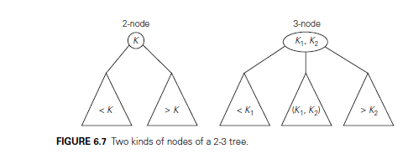
Example: 2-3 trees

Slide 80
Example: Construct a 2-3 Tree for the following array:
9, 5, 8, 3, 2, 4, 7
Procedure
Insert the key into the leaf after going by an appropriate branch.
If a node has more than 1 or 2 keys, make sure they are in order. If 3 keys are there, then promote middle one as parent. If node with 3 keys is a root, split it & create a new root with middle key.
Repeat i) ii) until all keys satisfy the properties.

Slide 81
Example: Construct a 2-3 Tree for the following array:
9, 5, 8, 3, 2, 4, 7
8
8
9
5,9
5,8,9
5
9
3,5
9
8
3,8
3,8
2,3,5
2
5
9
2
4,5
9
9
3,8
3,5,8
5
3
8
2
4,5,7
9
2
4
7
9
2
4
7
9

Slide 83
Module 3 Syllabus
TRANSFORM-AND-CONQUER: Balanced Search Trees, Heaps and Heapsort.
SPACE-TIME TRADEOFFS: Sorting by Counting: Comparison counting sort, Input Enhancement in String Matching: Horspool’s Algorithm.
Chapter 6 (Sections 6.3, 6.4),
Chapter 7 (Sections 7.1, 7.2)

Slide 84
Heap and Heapsort
Heap can be defined as a Binary Tree with keys assigned to its nodes, one key per node, provided the following two conditions are met:
The Shape Property: It is essentially complete Binary tree that is all its levels are full except possibly last level, where only some right leaves may be missing.
The Parental Dominance (or Heap Property): The key in each node is greater than or equal to the keys in its children.

Slide 85
Example of Heaps non-Heaps
10
10
10
5
7
5
7
5
7
2
1
4
2
1
6
2
1
Not Heap Because the tree’s shape property is violated.
Not Heap Because Parental Dominance fails for the node with the key 5.
Heap

Slide 86
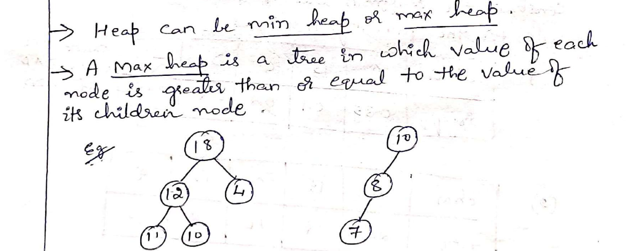

Slide 87
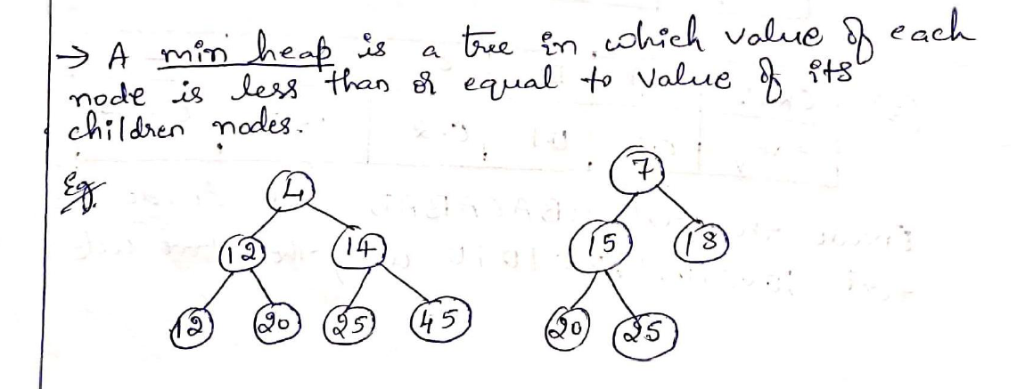

Slide 88
Write the array representation for the given heap.
10
8
7
5
2
1
6
3
5
1
0 | 1 | 2 | 3 | 4 | 5 | 6 | 7 | 8 | 9 | 10
 | 10 | 8 | 7 | 5 | 2 | 1 | 6 | 3 | 5 | 1
Parents |  |  |  |  |  | Leaves

Slide 89
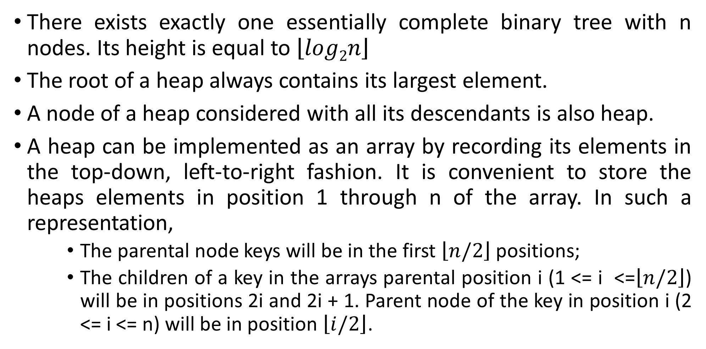
The Properties if the Heap
There exists exactly one essentially complete binary tree with n nodes. Its height is equal to $\left\lfloor log2n\right\rfloor$
The root of a heap always contains its largest element.
A node of a heap considered with all its descendants is also heap.
A heap can be implemented as an array by recording its elements in the top-down, left-to-right fashion. It is convenient to store the heaps elements in position 1 through n of the array. In such a representation,
    The parental node keys will be in the first $\left\lfloor n/2\right\rfloor$ positions;
    The children of a key in the arrays parental position i (1 <= i <=$\left\lfloor n/2\right\rfloor$) will be in positions 2i and 2i + 1. Parent node of the key in position i (2 <= i <= n) will be in position $\left\lfloor i/2\right\rfloor$.

Slide 90
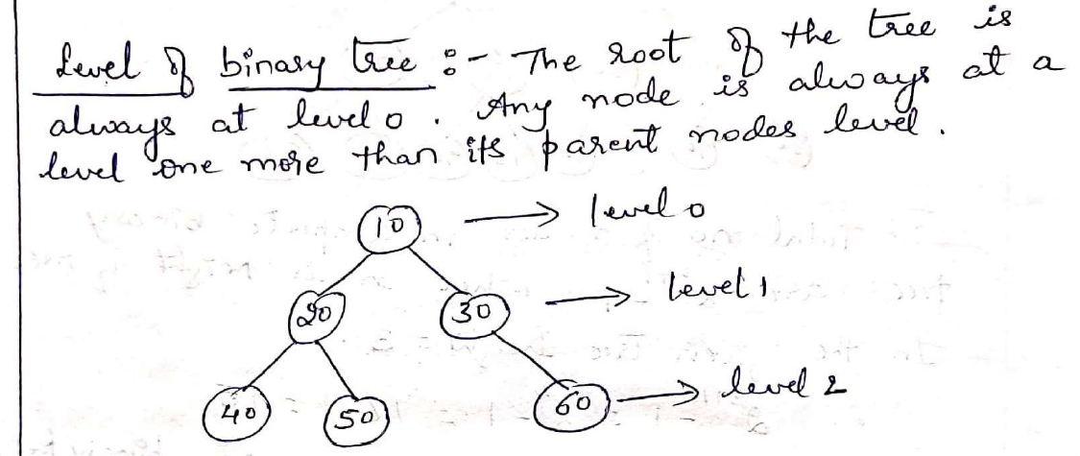

Slide 91
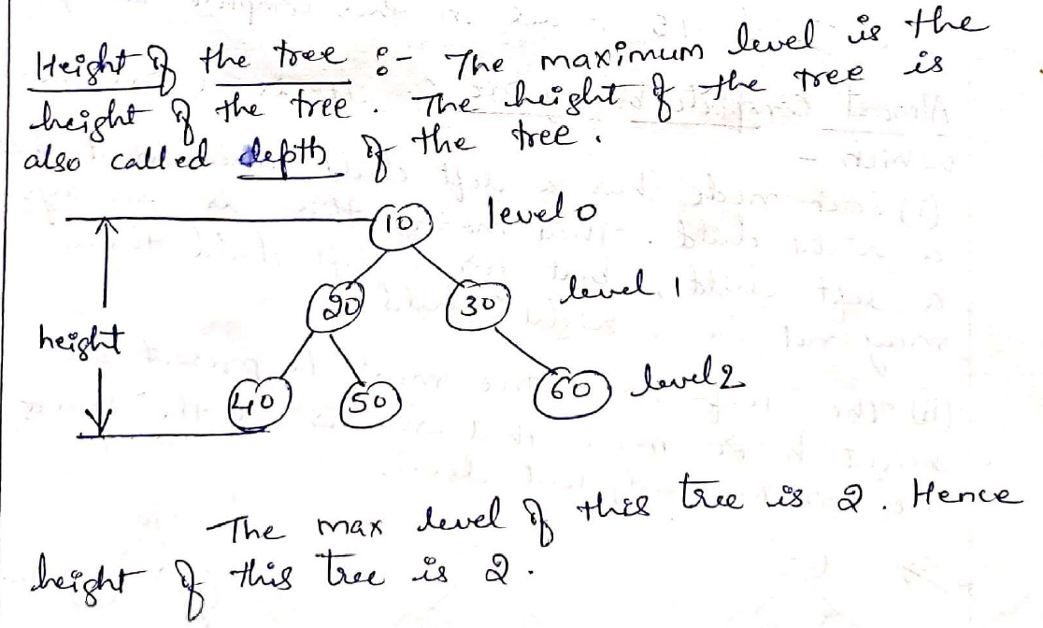

Slide 92
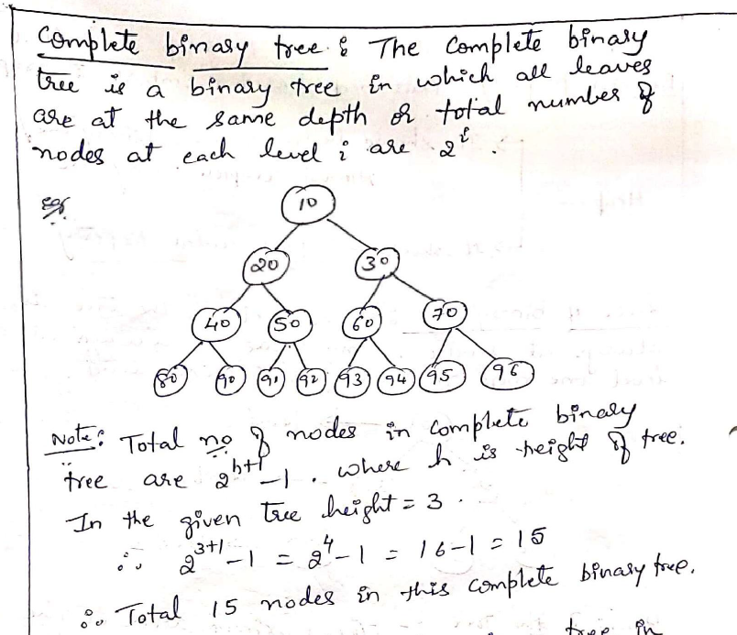

Slide 94
Bottom-up construction of a heap for the list
Initialize essentially complete binary tree with n nodes by placing the keys in the order given.
Heapify the tree as follows:
    Start with the last parental node.
    Check whether the parental dominance holds for the key in this node. If it does not, exchange the node’s key K with the larger key of its children and checks whether the parental dominance holds for key in its new position.
    Continue this process until the parental dominance for K is satisfied.

Slide 95
Construct a heap for the list: 2, 9, 7, 6, 5, 8 using Bottom-up construction
2
Start with the last parental node.
Here, last parental node is the node 7
9
7
6
5
8

Slide 96
Construct a heap for the list: 2, 9, 7, 6, 5, 8 using Bottom-up construction
2
Start with the last parental node.
Here, last parental node is the node 7
Node 7, contains only 1 child node and the key of node 8 is greater than the key of node 7, so it does not hold the parental dominance. So, swap.
9
7
6
5
8

Slide 97
Construct a heap for the list: 2, 9, 7, 6, 5, 8 using Bottom-up construction
2
Start with the last parental node.
Here, last parental node is the node 7.
Node 7, contains only 1 child node and the key of node 8 is greater than the key of node 7, so it does not hold the parental dominance. So, swap.
9
7
6
5
8

Slide 98
Construct a heap for the list: 2, 9, 7, 6, 5, 8 using Bottom-up construction
2
9
8
6
5
7

Slide 99
Construct a heap for the list: 2, 9, 7, 6, 5, 8 using Bottom-up construction
2
Now consider the parental node 9. It has two children. The node 9 holds the parental dominance.
9
8
6
5
7

Slide 100
Construct a heap for the list: 2, 9, 7, 6, 5, 8 using Bottom-up construction
2
Now consider the parental node 9. It has two children. The node 9 holds the parental dominance. No swap.
9
8
6
5
7

Slide 101
Construct a heap for the list: 2, 9, 7, 6, 5, 8 using Bottom-up construction
2
Now consider the parental node 2.
9
8
6
5
7

Slide 102
Construct a heap for the list: 2, 9, 7, 6, 5, 8 using Bottom-up construction
2
Now consider the parental node 2. It has two children. The node 2 does not holds the parental dominance. Node 9 is greater than node 8, swap Node 2 with node 9.
9
8
6
5
7

Slide 103
Construct a heap for the list: 2, 9, 7, 6, 5, 8 using Bottom-up construction
2
Now consider the parental node 2. It has two children. The node 2 does not holds the parental dominance. Node 9 is greater than node 8, swap Node 2 with node 9.
9
8
6
5
7

Slide 104
Construct a heap for the list: 2, 9, 7, 6, 5, 8 using Bottom-up construction
9
2
8
6
5
7

Slide 105
Construct a heap for the list: 2, 9, 7, 6, 5, 8 using Bottom-up construction
9
Now again consider the parental node 2. It has two children. The node 2 does not holds the parental dominance. Since Node 6 is greater than node 5, swap Node 2 with node 6.
2
8
6
5
7

Slide 106
Construct a heap for the list: 2, 9, 7, 6, 5, 8 using Bottom-up construction
9
6
8
2
5
7

Slide 107
Construct a heap for the list: 2, 9, 7, 6, 5, 8 using Bottom-up construction
9
Now All nodes are satisfying the Parental Dominance.
So, This tree is a heap.
The Array representation of this heap is:
9, 6, 8, 2, 5, 7
6
8
2
5
7

Slide 108
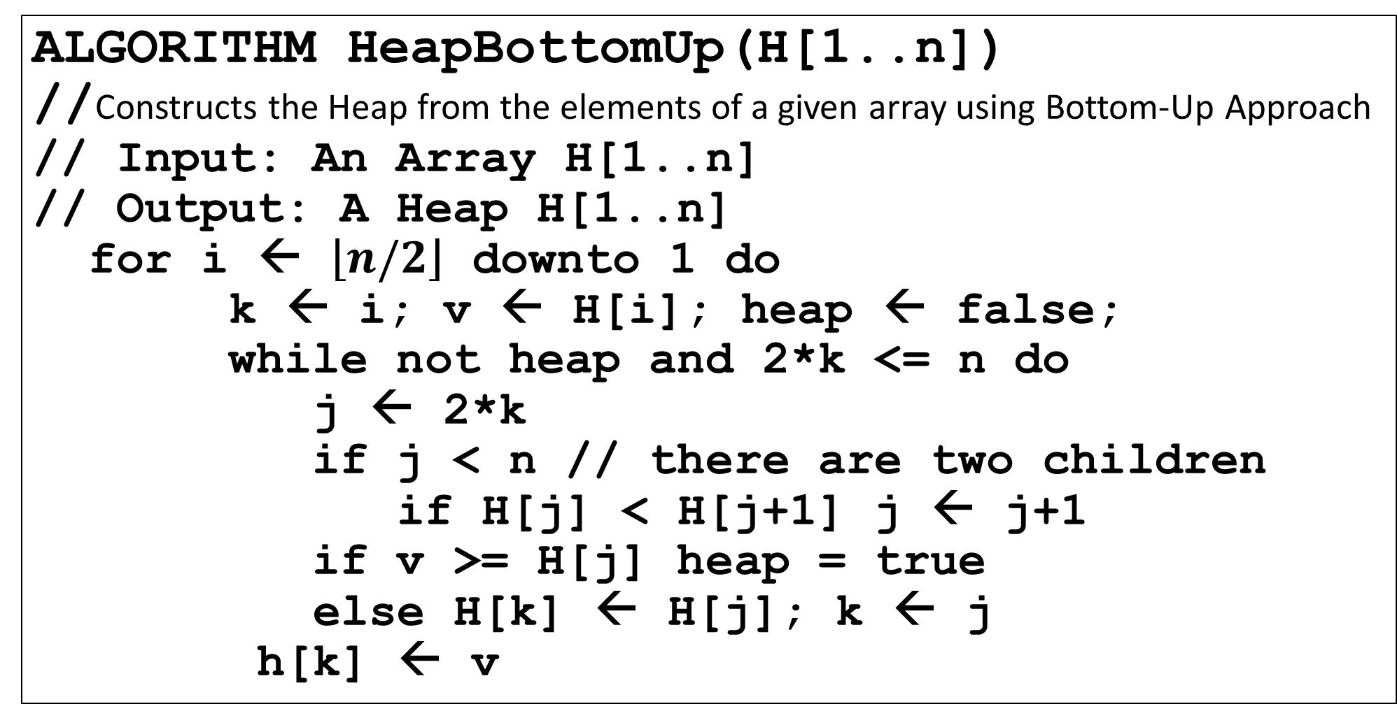
Algorithm for Bottom-up Heap Construction
ALGORITHM HeapBottomUp(H[1..n])
//Constructs the Heap from the elements of a given array using Bottom-Up Approach
// Input: An Array H[1..n]
// Output: A Heap H[1..n]
for i ← $\left\lfloor n/2\right\rfloor$ downto 1 do
k ← i; v ← H[i]; heap ← false;
while not heap and 2*k <= n do
j ← 2*k
if j < n // there are two children
if H[j] < H[j+1] j ← j+1
if v >= H[j] heap = true
else H[k] ← H[j]; k ← j
h[k] ← v

Slide 109
The Properties of the Heap (Repeated in Slide 85)
There exists exactly one essentially complete binary tree with n nodes. Its height is equal to $\left\lfloor log2n\right\rfloor$
The root of a heap always contains its largest element.
A node of a heap considered with all its descendants is also heap.
A heap can be implemented as an array by recording its elements in the top-down, left-to-right fashion. It is convenient to store the heaps elements in position 1 through n of the array. In such a representation,
    The parental node keys will be in the first $\left\lfloor n/2\right\rfloor$ positions;
    The children of a key in the arrays parental position i (1 <= i <=$\left\lfloor n/2\right\rfloor$) will be in positions 2i and 2i + 1. Parent node of the key in position i (2 <= i <= n) will be in position $\left\lfloor i/2\right\rfloor$.

Slide 110
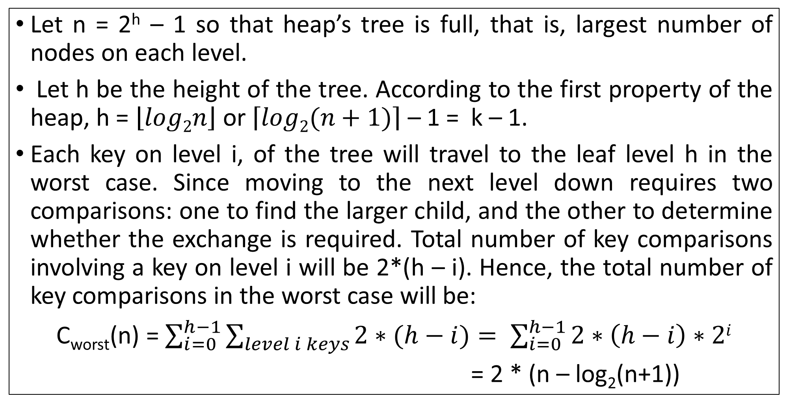
Efficiency Analysis of HeapBottomUp
Let n = 2^{h} – 1 so that heap’s tree is full, that is, largest number of nodes on each level.
Let h be the height of the tree. According to the first property of the heap, h = $\left\lfloor log2n\right\rfloor$ or $\left\lceil log2(n+1)\right\rceil$ – 1 = k – 1.
Each key on level i, of the tree will travel to the leaf level h in the worst case. Since moving to the next level down requires two comparisons: one to find the larger child, and the other to determine whether the exchange is required. Total number of key comparisons involving a key on level i will be 2*(h – i). Hence, the total number of key comparisons in the worst case will be:
C_{worst}(n) = $\sum_{i=0}^{h−1}{\sum_{level i keys}{2∗(h−i)}}= \sum_{i=0}^{h−1}{2∗\left(h−i\right)∗2i}$
= 2 * (n – log₂(n+1))

Slide 111
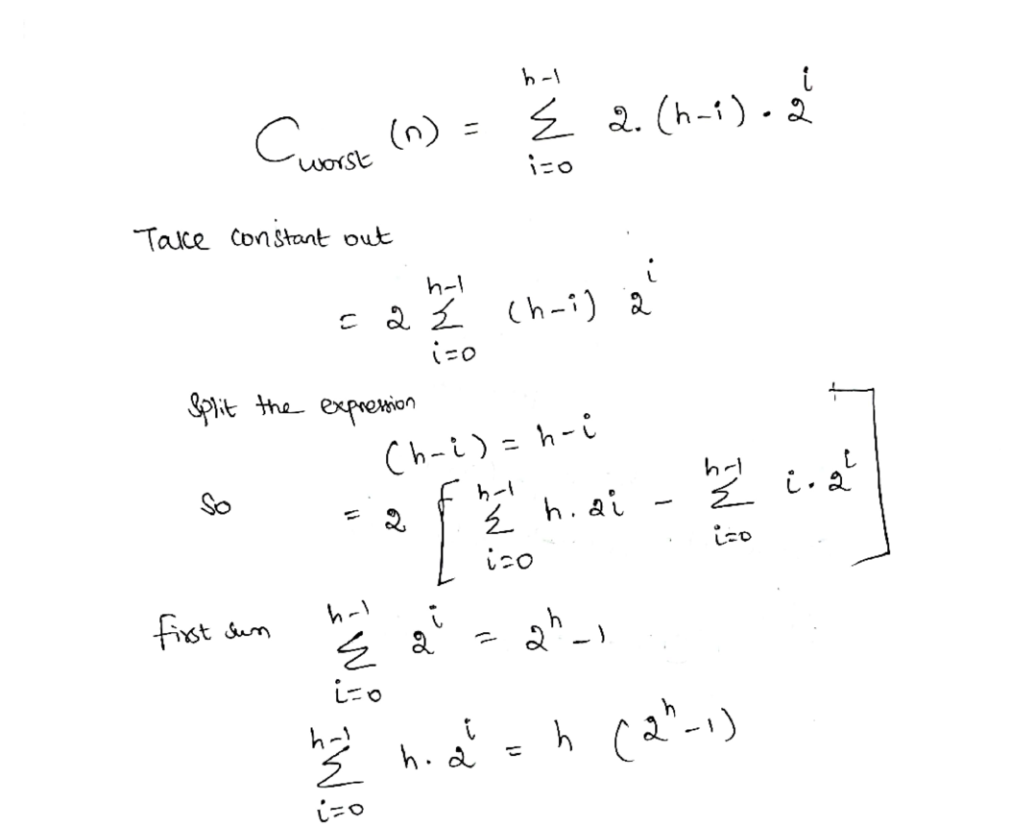

Slide 112
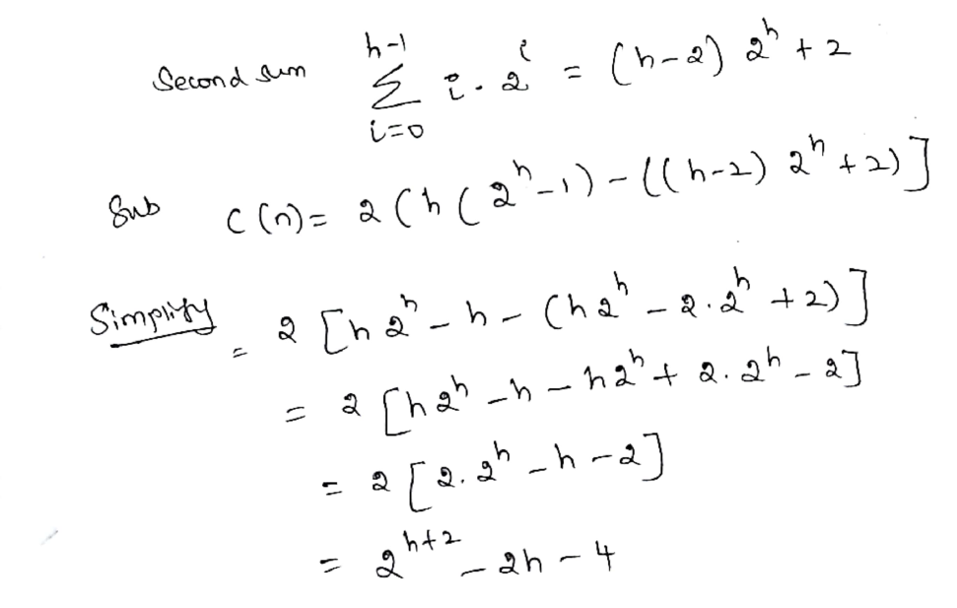

Slide 113
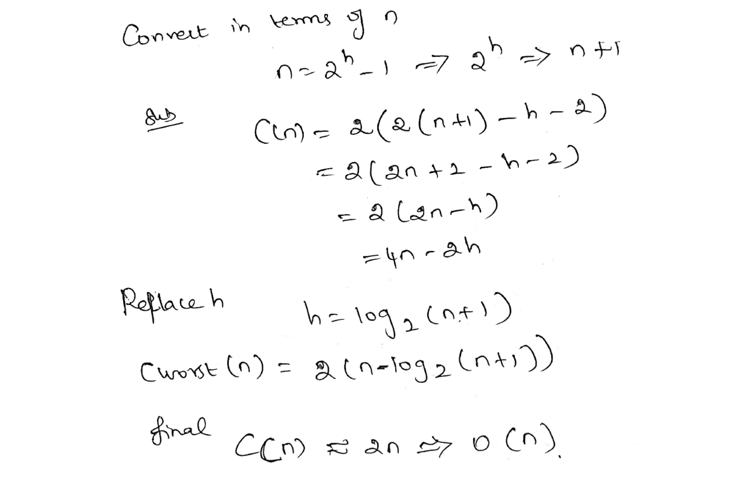

Slide 114
How we can insert an element into the given heap?
First attach a new node with the key K in it after the last leaf of the existing heap.
Shift K up to appropriate place in the new heap as follows:
    Compare K with its parent keys. If parent Key >= K, stop, otherwise swap these two keys and compare K with the new parent. This process continues until K is not greater than its last parent or it reaches the root.
This insertion cannot require more key comparisons than the heap’s height.
Since the height of the heap with n nodes is about log₂n, the time efficiency of insertion is in O(log₂n)

Slide 115
Insert an Element 10 into the given heap
First attach a new node with the key 10 in it after the last leaf of the existing heap.
9
6
8
2
5
7

Slide 116
Insert an Element 10 into the given heap
First attach a new node with the key 10 in it after the last leaf of the existing heap.
9
6
8
2
5
7
10

Slide 117
Insert an Element 10 into the given heap
First attach a new node with the key 10 in it after the last leaf of the existing heap.
Compare the key 10 with its parent key (here it is 8).
    Since 10 > 8, swap 10 and 8
9
6
8
2
5
7
10

Slide 118
Insert an Element 10 into the given heap
First attach a new node with the key 10 in it after the last leaf of the existing heap.
Compare the key 10 with its parent key (here it is 8).
    Since 10 > 8, swap 10 and 8
9
6
10
2
5
7
8

Slide 119
Insert an Element 10 into the given heap
First attach a new node with the key 10 in it after the last leaf of the existing heap.
Compare the key 10 with its parent key (here it is 8).
    Since 10 > 8, swap 10 and 8
Compare the key 10 with its new parent key (here it is 9)
    Since 10 > 9. swap 10, and 9
9
6
10
2
5
7
8

Slide 120
Insert an Element 10 into the given heap
First attach a new node with the key 10 in it after the last leaf of the existing heap.
Compare the key 10 with its parent key (here it is 8).
    Since 10 > 8, swap 10 and 8
Compare the key 10 with its new parent key (here it is 9)
    Since 10 > 9. swap 10, and 9
Since the key is in root, stop.
Resultant heap is:
10, 6, 9, 2, 5, 7, 8
10
6
9
2
5
7
8

Slide 121
How to delete the element from the heap?
Maximum Key Deletion from the heap
Step 1: Exchange the root’s key with the last key K in the heap.
Step 2: Decrease the heap size by 1
Step 3: Heapify the smaller tree by shifting K down the tree.
9
8
6
2
5
1
1
8
1
Step 1
Step 2
Step 3
8
6
5
6
8
6
2
5
2
1
2
5
9

Slide 122
Module 3 Syllabus
TRANSFORM-AND-CONQUER: Balanced Search Trees, Heaps and Heapsort.
SPACE-TIME TRADEOFFS: Sorting by Counting: Comparison counting sort, Input Enhancement in String Matching: Horspool’s Algorithm.
Chapter 6 (Sections 6.3, 6.4),
Chapter 7 (Sections 7.1, 7.2)

Slide 123
Heap Sort
Heap Sort is a two stage Algorithm:
    Heap Construction (Max heap): Construct a max heap for a given array.
    Maximum Deletions: Apply the root deletion operation n – 1 number of times.

Slide 124
Example: Sort the given array using Heap Sort
2, 9, 7, 6, 5, 8
First Step: Heap Construction
2
2
2
2
9
7
9
7
9
8
9
8
6
5
8
6
5
8
6
5
7
6
5
7
9
9
2
2
8
6
8
9
8
6
5
7
2
5
7
6
5
7
After Heap: The Array is : 9, 6, 8, 2, 5, 7

Slide 125
Example: Sort the given array using Heap Sort
2, 9, 7, 6, 5, 8
Second Step: Deletion from the root
9
Swap root 9 with last leaf 7
7
7
Heapify
8
Delete 9
6
8
6
8
6
8
6
7
2
5
7
2
5
9
2
5
2
5
9
Swap root 8 with last leaf 5
8
5
Delete 8
7
5
Heapify
6
7
6
7
6
5
6
7
2
5
2
8
2
2
9, 8

Slide 126
Example: Sort the given array using Heap Sort
2, 9, 7, 6, 5, 8
Second Step: Deletion from the root
Swap root 7 with last leaf 2
2
6
2
Heapify
7
Delete 7
6
5
2
5
6
5
6
5
2
7
9, 8, 7
Swap root 6 with last leaf 5
Delete 6
Heapify
6
5
5
5
2
5
2
6
2
2
9, 8, 7, 6

Slide 127
Example: Sort the given array using Heap Sort
2, 9, 7, 6, 5, 8
Second Step: Deletion from the root
Swap root 5 with last leaf 2
Heapify
Delete 5
5
2
2
2
2
5
9, 8, 7, 6, 5
Only one element is 2
Delete 2
2
2
9, 8, 7, 6, 5, 2
After Sorting, the Array is: 9, 8, 7, 6, 5, 2

Slide 128
Module 3 Syllabus
TRANSFORM-AND-CONQUER: Balanced Search Trees, Heaps and Heapsort.
SPACE-TIME TRADEOFFS: Sorting by Counting: Comparison counting sort, Input Enhancement in String Matching: Horspool’s Algorithm.
Chapter 6 (Sections 6.3, 6.4),
Chapter 7 (Sections 7.1, 7.2)

Slide 129
Sorting By Counting (Input Enhancement)
For each element of the list to be sorted, count the total number of elements smaller than this element and record the results in the table.
These numbers will indicate the positions of the elements in the sorted list. So, Copy the list elements to their appropriate positions in a new sorted list.
This algorithm is called as Sorting by Comparison Counting.

Slide 130
Example of Sorting by Counting
Consider the input array: 62, 31, 84, 96, 19, 47
For each elements, Count the number of elements number of elements smaller than or equal to the current element. Store the result in the count array.
Copy the values of the original array elements to the new array in the positions specified by the count array.

Slide 131
Example of Sorting by Counting
Consider the input array: 62, 31, 84, 96, 19, 47
Array A[0..5] | 62 | 31 | 84 | 96 | 19 | 47

Slide 132
Example of Sorting by Counting
Consider the input array: 62, 31, 84, 96, 19, 47
Array A[0..5] |  |  |  | 62 | 31 | 84 | 96 | 19 | 47
Initially, |  | Count[] |  | 0 | 0 | 0 | 0 | 0 | 0
Initialize all the element of the count array to 0

Slide 133
Example of Sorting by Counting
Consider the input array: 62, 31, 84, 96, 19, 47
Array A[0..5] |  |  |  | 62 | 31 | 84 | 96 | 19 | 47
Initially, |  | Count[] |  | 0 | 0 | 0 | 0 | 0 | 0
Initialize all the element of the count array to 0
Let i = 0.
For each j from i + 1 to n–1, Calculate Count values.
If A[i] < A[j], increment count[j]
else, increment count[i]. With this, after i=0, we get…

Slide 134
Example of Sorting by Counting
Consider the input array: 62, 31, 84, 96, 19, 47
Array A[0..5] |  |  |  | 62 | 31 | 84 | 96 | 19 | 47
Initially, |  | Count[] |  | 0 | 0 | 0 | 0 | 0 | 0
After i = 0 |  | Count[] |  | 3 | 0 | 1 | 1 | 0 | 0

Slide 135
Example of Sorting by Counting
Consider the input array: 62, 31, 84, 96, 19, 47
Array A[0..5] |  |  |  | 62 | 31 | 84 | 96 | 19 | 47
Initially, |  | Count[] |  | 0 | 0 | 0 | 0 | 0 | 0
After i = 0 |  | Count[] |  | 3 | 0 | 1 | 1 | 0 | 0
Now, i = 1.
For each j from i + 1 to n–1, Calculate Count values.
If A[i] > A[j], increment count[j]
else, increment count[i]. With this, after i = 1, we get…

Slide 136
Example of Sorting by Counting
Consider the input array: 62, 31, 84, 96, 19, 47
Array A[0..5] |  |  |  | 62 | 31 | 84 | 96 | 19 | 47
Initially, |  | Count[] |  | 0 | 0 | 0 | 0 | 0 | 0
After i = 0 |  | Count[] |  | 3 | 0 | 1 | 1 | 0 | 0
After i = 1 |  | Count[] |  | 3 | 1 | 2 | 2 | 0 | 1

Slide 137
Example of Sorting by Counting
Consider the input array: 62, 31, 84, 96, 19, 47
Array A[0..5] |  |  |  | 62 | 31 | 84 | 96 | 19 | 47
Initially, |  | Count[] |  | 0 | 0 | 0 | 0 | 0 | 0
After i = 0 |  | Count[] |  | 3 | 0 | 1 | 1 | 0 | 0
After i = 1 |  | Count[] |  | 3 | 1 | 2 | 2 | 0 | 1
After i = 2 |  | Count[] |  | 3 | 1 | 4 | 3 | 0 | 1
After i = 3 |  | Count[] |  | 3 | 1 | 4 | 5 | 0 | 2
After i = 4 |  | Count[] |  | 3 | 1 | 4 | 5 | 0 | 2

Slide 138
Example of Sorting by Counting
Consider the input array: 62, 31, 84, 96, 19, 47
Array A[0..5] |  |  |  | 62 | 31 | 84 | 96 | 19 | 47
Initially, |  | Count[] |  | 0 | 0 | 0 | 0 | 0 | 0
After i = 0 |  | Count[] |  | 3 | 0 | 1 | 1 | 0 | 0
After i = 1 |  | Count[] |  | 3 | 1 | 2 | 2 | 0 | 1
After i = 2 |  | Count[] |  | 3 | 1 | 4 | 3 | 0 | 1
After i = 3 |  | Count[] |  | 3 | 1 | 4 | 5 | 0 | 2
After i = 4 |  | Count[] |  | 3 | 1 | 4 | 5 | 0 | 2
Array S[0..5]

Slide 139
Example of Sorting by Counting
Consider the input array: 62, 31, 84, 96, 19, 47
Array A[0..5] |  |  |  | 62 | 31 | 84 | 96 | 19 | 47
Initially, |  | Count[] |  | 0 | 0 | 0 | 0 | 0 | 0
After i = 0 |  | Count[] |  | 3 | 0 | 1 | 1 | 0 | 0
After i = 1 |  | Count[] |  | 3 | 1 | 2 | 2 | 0 | 1
After i = 2 |  | Count[] |  | 3 | 1 | 4 | 3 | 0 | 1
After i = 3 |  | Count[] |  | 3 | 1 | 4 | 5 | 0 | 2
After i = 4 |  | Count[] |  | 3 | 1 | 4 | 5 | 0 | 2
Array S[0..5]
S[3] = A[0] = 62

Slide 140
Example of Sorting by Counting
Consider the input array: 62, 31, 84, 96, 19, 47
Array A[0..5] |  |  |  | 62 | 31 | 84 | 96 | 19 | 47
Initially, |  | Count[] |  | 0 | 0 | 0 | 0 | 0 | 0
After i = 0 |  | Count[] |  | 3 | 0 | 1 | 1 | 0 | 0
After i = 1 |  | Count[] |  | 3 | 1 | 2 | 2 | 0 | 1
After i = 2 |  | Count[] |  | 3 | 1 | 4 | 3 | 0 | 1
After i = 3 |  | Count[] |  | 3 | 1 | 4 | 5 | 0 | 2
After i = 4 |  | Count[] |  | 3 | 1 | 4 | 5 | 0 | 2
Array S[0..5] |  |  |  |  |  |  | 62

Slide 141
Example of Sorting by Counting
Consider the input array: 62, 31, 84, 96, 19, 47
Array A[0..5] |  |  |  | 62 | 31 | 84 | 96 | 19 | 47
Initially, |  | Count[] |  | 0 | 0 | 0 | 0 | 0 | 0
After i = 0 |  | Count[] |  | 3 | 0 | 1 | 1 | 0 | 0
After i = 1 |  | Count[] |  | 3 | 1 | 2 | 2 | 0 | 1
After i = 2 |  | Count[] |  | 3 | 1 | 4 | 3 | 0 | 1
After i = 3 |  | Count[] |  | 3 | 1 | 4 | 5 | 0 | 2
After i = 4 |  | Count[] |  | 3 | 1 | 4 | 5 | 0 | 2
Array S[0..5] |  |  |  |  |  |  | 62
S[1] = A[1] = 31

Slide 142
Example of Sorting by Counting
Consider the input array: 62, 31, 84, 96, 19, 47
Array A[0..5] |  |  |  | 62 | 31 | 84 | 96 | 19 | 47
Initially, |  | Count[] |  | 0 | 0 | 0 | 0 | 0 | 0
After i = 0 |  | Count[] |  | 3 | 0 | 1 | 1 | 0 | 0
After i = 1 |  | Count[] |  | 3 | 1 | 2 | 2 | 0 | 1
After i = 2 |  | Count[] |  | 3 | 1 | 4 | 3 | 0 | 1
After i = 3 |  | Count[] |  | 3 | 1 | 4 | 5 | 0 | 2
After i = 4 |  | Count[] |  | 3 | 1 | 4 | 5 | 0 | 2
Array S[0..5] |  |  |  |  | 31 |  | 62

Slide 143
Example of Sorting by Counting
Consider the input array: 62, 31, 84, 96, 19, 47
Array A[0..5] |  |  |  | 62 | 31 | 84 | 96 | 19 | 47
Initially, |  | Count[] |  | 0 | 0 | 0 | 0 | 0 | 0
After i = 0 |  | Count[] |  | 3 | 0 | 1 | 1 | 0 | 0
After i = 1 |  | Count[] |  | 3 | 1 | 2 | 2 | 0 | 1
After i = 2 |  | Count[] |  | 3 | 1 | 4 | 3 | 0 | 1
After i = 3 |  | Count[] |  | 3 | 1 | 4 | 5 | 0 | 2
After i = 4 |  | Count[] |  | 3 | 1 | 4 | 5 | 0 | 2
Array S[0..5] |  |  |  |  | 31 |  | 62
S[4] = A[2] = 84

Slide 144
Example of Sorting by Counting
Consider the input array: 62, 31, 84, 96, 19, 47
Array A[0..5] |  |  |  | 62 | 31 | 84 | 96 | 19 | 47
Initially, |  | Count[] |  | 0 | 0 | 0 | 0 | 0 | 0
After i = 0 |  | Count[] |  | 3 | 0 | 1 | 1 | 0 | 0
After i = 1 |  | Count[] |  | 3 | 1 | 2 | 2 | 0 | 1
After i = 2 |  | Count[] |  | 3 | 1 | 4 | 3 | 0 | 1
After i = 3 |  | Count[] |  | 3 | 1 | 4 | 5 | 0 | 2
After i = 4 |  | Count[] |  | 3 | 1 | 4 | 5 | 0 | 2
Array S[0..5] |  |  |  |  | 31 |  | 62 | 84

Slide 145
Example of Sorting by Counting
Consider the input array: 62, 31, 84, 96, 19, 47
Array A[0..5] |  |  |  | 62 | 31 | 84 | 96 | 19 | 47
Initially, |  | Count[] |  | 0 | 0 | 0 | 0 | 0 | 0
After i = 0 |  | Count[] |  | 3 | 0 | 1 | 1 | 0 | 0
After i = 1 |  | Count[] |  | 3 | 1 | 2 | 2 | 0 | 1
After i = 2 |  | Count[] |  | 3 | 1 | 4 | 3 | 0 | 1
After i = 3 |  | Count[] |  | 3 | 1 | 4 | 5 | 0 | 2
After i = 4 |  | Count[] |  | 3 | 1 | 4 | 5 | 0 | 2
Array S[0..5] |  |  |  |  | 31 |  | 62 | 84
S[5] = A[3] = 96

Slide 146
Example of Sorting by Counting
Consider the input array: 62, 31, 84, 96, 19, 47
Array A[0..5] |  |  |  | 62 | 31 | 84 | 96 | 19 | 47
Initially, |  | Count[] |  | 0 | 0 | 0 | 0 | 0 | 0
After i = 0 |  | Count[] |  | 3 | 0 | 1 | 1 | 0 | 0
After i = 1 |  | Count[] |  | 3 | 1 | 2 | 2 | 0 | 1
After i = 2 |  | Count[] |  | 3 | 1 | 4 | 3 | 0 | 1
After i = 3 |  | Count[] |  | 3 | 1 | 4 | 5 | 0 | 2
After i = 4 |  | Count[] |  | 3 | 1 | 4 | 5 | 0 | 2
Array S[0..5] |  |  |  |  | 31 |  | 62 | 84 | 96

Slide 147
Example of Sorting by Counting
Consider the input array: 62, 31, 84, 96, 19, 47
Array A[0..5] |  |  |  | 62 | 31 | 84 | 96 | 19 | 47
Initially, |  | Count[] |  | 0 | 0 | 0 | 0 | 0 | 0
After i = 0 |  | Count[] |  | 3 | 0 | 1 | 1 | 0 | 0
After i = 1 |  | Count[] |  | 3 | 1 | 2 | 2 | 0 | 1
After i = 2 |  | Count[] |  | 3 | 1 | 4 | 3 | 0 | 1
After i = 3 |  | Count[] |  | 3 | 1 | 4 | 5 | 0 | 2
After i = 4 |  | Count[] |  | 3 | 1 | 4 | 5 | 0 | 2
Array S[0..5] |  |  |  |  | 31 |  | 62 | 84 | 96
S[0] = A[4] = 19

Slide 148
Example of Sorting by Counting
Consider the input array: 62, 31, 84, 96, 19, 47
Array A[0..5] |  |  |  | 62 | 31 | 84 | 96 | 19 | 47
Initially, |  | Count[] |  | 0 | 0 | 0 | 0 | 0 | 0
After i = 0 |  | Count[] |  | 3 | 0 | 1 | 1 | 0 | 0
After i = 1 |  | Count[] |  | 3 | 1 | 2 | 2 | 0 | 1
After i = 2 |  | Count[] |  | 3 | 1 | 4 | 3 | 0 | 1
After i = 3 |  | Count[] |  | 3 | 1 | 4 | 5 | 0 | 2
After i = 4 |  | Count[] |  | 3 | 1 | 4 | 5 | 0 | 2
Array S[0..5] |  |  |  | 19 | 31 |  | 62 | 84 | 96

Slide 149
Example of Sorting by Counting
Consider the input array: 62, 31, 84, 96, 19, 47
Array A[0..5] |  |  |  | 62 | 31 | 84 | 96 | 19 | 47
Initially, |  | Count[] |  | 0 | 0 | 0 | 0 | 0 | 0
After i = 0 |  | Count[] |  | 3 | 0 | 1 | 1 | 0 | 0
After i = 1 |  | Count[] |  | 3 | 1 | 2 | 2 | 0 | 1
After i = 2 |  | Count[] |  | 3 | 1 | 4 | 3 | 0 | 1
After i = 3 |  | Count[] |  | 3 | 1 | 4 | 5 | 0 | 2
After i = 4 |  | Count[] |  | 3 | 1 | 4 | 5 | 0 | 2
Array S[0..5] |  |  |  | 19 | 31 |  | 62 | 84 | 96
S[2] = A[5] = 47

Slide 150
Example of Sorting by Counting
Consider the input array: 62, 31, 84, 96, 19, 47
Array A[0..5] |  |  |  | 62 | 31 | 84 | 96 | 19 | 47
Initially, |  | Count[] |  | 0 | 0 | 0 | 0 | 0 | 0
After i = 0 |  | Count[] |  | 3 | 0 | 1 | 1 | 0 | 0
After i = 1 |  | Count[] |  | 3 | 1 | 2 | 2 | 0 | 1
After i = 2 |  | Count[] |  | 3 | 1 | 4 | 3 | 0 | 1
After i = 3 |  | Count[] |  | 3 | 1 | 4 | 5 | 0 | 2
After i = 4 |  | Count[] |  | 3 | 1 | 4 | 5 | 0 | 2
Array S[0..5] |  |  |  | 19 | 31 | 47 | 62 | 84 | 96

Slide 151
Algorithm for Sorting By Counting
ALGORITHM ComparisonCountingSort(A[0..n-1])
// Sorts an array by comparison counting
// Input: An Array A[0..n-1]
// Output: An Array S[0..n-1] of A’s Sorted.
for i ← 0 to n-1 do Count[i] ← 0
for i ← 0 to n-2 do
for j ← i+1 to n-1 do
if A[i] < A[j] Count[j]++
else count[i]++
for i ← 0 to n-1 do S[Count[i]] ← A[i]
return S

Slide 152
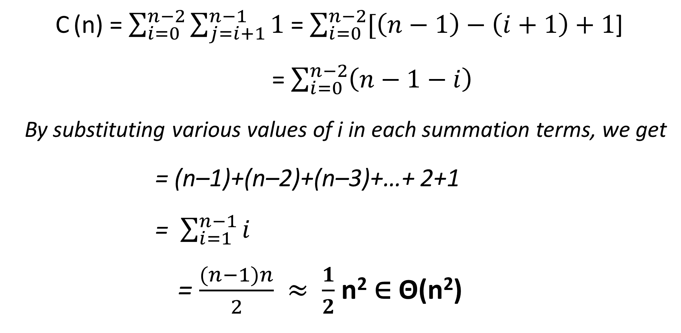
Analysis of the Efficiency
C (n) = $\sum_{i=0}^{n−2}{\sum_{j=i+1}^{n−1}{1}}$ = $\sum_{i=0}^{n−2}{[\left(n−1\right)−\left(i+1\right)+1}$]
= $\sum_{i=0}^{n−2}{\left(n−1−i\right)}$
By substituting various values of i in each summation terms, we get
= (n–1)+(n–2)+(n–3)+…+ 2+1
= $\sum_{i=1}^{n−1}{i}$
= $\frac{(n−1)n}{2}$ $≈$ $\frac{1}{2}$ n² $\text{∈}$ Θ(n²)

Slide 153
Second Method is Sorting By Distribution Counting
Consider the following Array Elements
0 | 1 | 2 | 3 | 4 | 5
13 | 11 | 12 | 13 | 12 | 12
The Unique elements of the array are: 11, 12, 13
The frequency and distribution arrays are as below:
 |  |  | 0 | 1 | 2
Array Values |  |  | 11 | 12 | 13
Frequencies |  |  | 1 | 3 | 2
Distribution Values |  |  | 1 | 4 | 6

Slide 154
A[5] = 12 |  | 1 | 4 | 6 |  |  |  |  | 12
A[4] = 12 |  | 1 | 3 | 6 |  |  |  | 12
A[3] = 13 |  | 1 | 2 | 6 |  |  |  |  |  |  | 13
A[2] = 12 |  | 1 | 2 | 5 |  |  | 12
A[1] = 11 |  | 1 | 1 | 5 |  | 11
A[0] = 13 |  | 0 | 1 | 5 |  |  |  |  |  | 13

Slide 155
ALGORITHM FOR SORTING BY DISTRIBUTED COUNTING
ALGORITHM DistributionCountingSort(0..n-1)
// Sorts an array using Distribution Counting
// Input: A[0..n-1]
// Output: Sorted Array S[0..n-1]
for j ← 0 to u-ℓ do D[j] ← 0
for i ← 1 to n-1 do D[A[i]-ℓ] ← D[A[i]-ℓ]+1
for j ← 1 to u-ℓ do D[j] ← D[j-1]+D[j]
for i ← n-1 downto 0 do
j ← A[i]-ℓ
S[D[j]-1] ← A[i]
D[j] ← D[j]-1
return S

Slide 156
Module 3 Syllabus
TRANSFORM-AND-CONQUER: Balanced Search Trees, Heaps and Heapsort.
SPACE-TIME TRADEOFFS: Sorting by Counting: Comparison counting sort, Input Enhancement in String Matching: Horspool’s Algorithm.
Chapter 6 (Sections 6.3, 6.4),
Chapter 7 (Sections 7.1, 7.2)

Slide 157
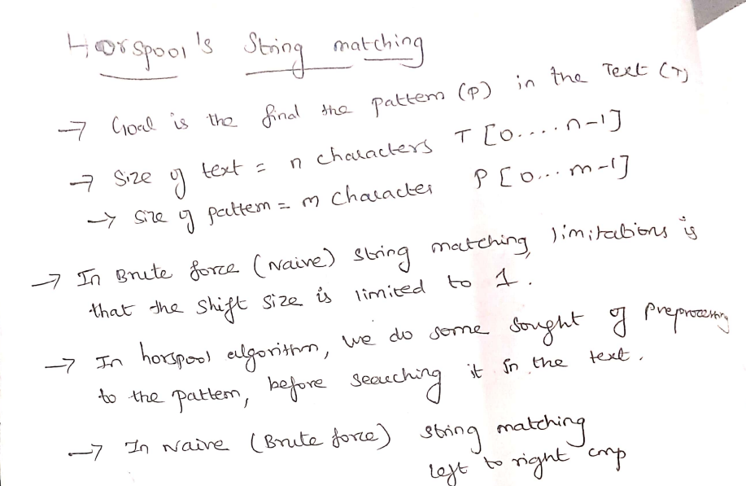
Horspool Algorithm

Slide 158
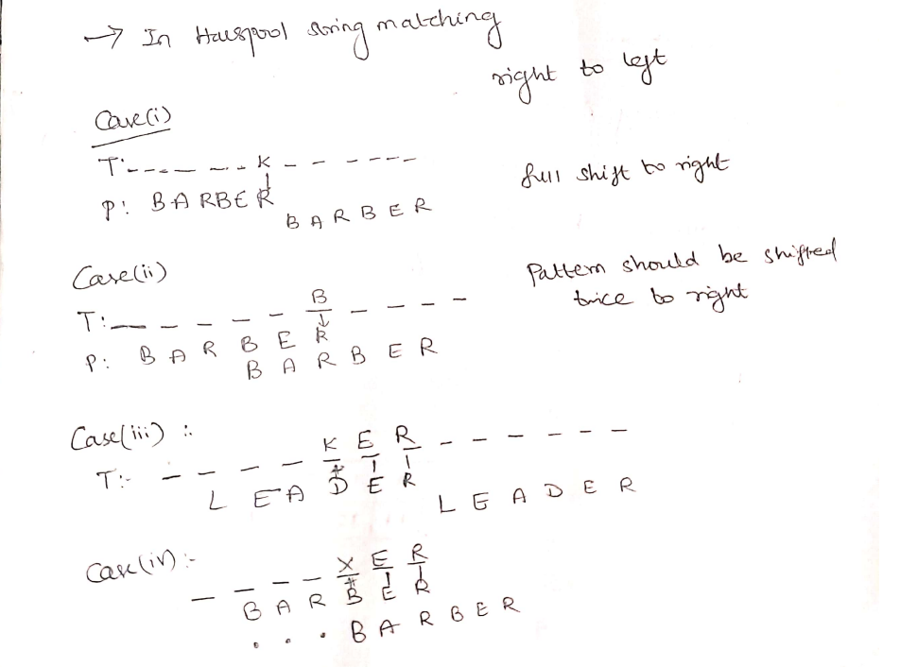
A

Slide 159
HORSPOOL ALGORITHM – An Example
0 | 1 | 2 | 3 | 4 | 5 | 6 | 7 | 8 | 9 | 10 | 11 | 12 | 13 | 14 | 15 | 16 | 17 | 18 | 19 | 20 | 21 | 22 | 23 | 24 | 25 | 26
J | I | M | _ | S | A | W | _ | M | E | _ | I | N | _ | A | _ | B | A | R | B | E | R | S | H | O | P
0 | 1 | 2 | 3 | 4 | 5
B | A | R | B | E | R
First Step is to create a Shifting Table.
A | B | C | D | E | F | G | H | I | J | K | L | M | N | O | P | Q | R | S | T | U | V | W | X | Y | Z

Slide 160
HORSPOOL ALGORITHM – An Example
0 | 1 | 2 | 3 | 4 | 5 | 6 | 7 | 8 | 9 | 10 | 11 | 12 | 13 | 14 | 15 | 16 | 17 | 18 | 19 | 20 | 21 | 22 | 23 | 24 | 25 | 26
J | I | M | _ | S | A | W | _ | M | E | _ | I | N | _ | A | _ | B | A | R | B | E | R | S | H | O | P
0 | 1 | 2 | 3 | 4 | 5
B | A | R | B | E | R
Initialize the shifting table values with the length of pattern.
A | B | C | D | E | F | G | H | I | J | K | L | M | N | O | P | Q | R | S | T | U | V | W | X | Y | Z
6 | 6 | 6 | 6 | 6 | 6 | 6 | 6 | 6 | 6 | 6 | 6 | 6 | 6 | 6 | 6 | 6 | 6 | 6 | 6 | 6 | 6 | 6 | 6 | 6 | 6 | 6

Slide 161
HORSPOOL ALGORITHM – An Example
0 | 1 | 2 | 3 | 4 | 5 | 6 | 7 | 8 | 9 | 10 | 11 | 12 | 13 | 14 | 15 | 16 | 17 | 18 | 19 | 20 | 21 | 22 | 23 | 24 | 25 | 26
J | I | M | _ | S | A | W | _ | M | E | _ | I | N | _ | A | _ | B | A | R | B | E | R | S | H | O | P
0 | 1 | 2 | 3 | 4 | 5
B | A | R | B | E | R
In Pattern, number of characters after E is 1. Fill 1 in E of shifting table
A | B | C | D | E | F | G | H | I | J | K | L | M | N | O | P | Q | R | S | T | U | V | W | X | Y | Z
6 | 6 | 6 | 6 | 6 | 6 | 6 | 6 | 6 | 6 | 6 | 6 | 6 | 6 | 6 | 6 | 6 | 6 | 6 | 6 | 6 | 6 | 6 | 6 | 6 | 6 | 6

Slide 162
HORSPOOL ALGORITHM – An Example
0 | 1 | 2 | 3 | 4 | 5 | 6 | 7 | 8 | 9 | 10 | 11 | 12 | 13 | 14 | 15 | 16 | 17 | 18 | 19 | 20 | 21 | 22 | 23 | 24 | 25 | 26
J | I | M | _ | S | A | W | _ | M | E | _ | I | N | _ | A | _ | B | A | R | B | E | R | S | H | O | P
0 | 1 | 2 | 3 | 4 | 5
B | A | R | B | E | R
In Pattern, number of characters after E is 1. Fill 1 in E of shifting table
A | B | C | D | E | F | G | H | I | J | K | L | M | N | O | P | Q | R | S | T | U | V | W | X | Y | Z
6 | 6 | 6 | 6 | 1 | 6 | 6 | 6 | 6 | 6 | 6 | 6 | 6 | 6 | 6 | 6 | 6 | 6 | 6 | 6 | 6 | 6 | 6 | 6 | 6 | 6 | 6

Slide 163
HORSPOOL ALGORITHM – An Example
0 | 1 | 2 | 3 | 4 | 5 | 6 | 7 | 8 | 9 | 10 | 11 | 12 | 13 | 14 | 15 | 16 | 17 | 18 | 19 | 20 | 21 | 22 | 23 | 24 | 25 | 26
J | I | M | _ | S | A | W | _ | M | E | _ | I | N | _ | A | _ | B | A | R | B | E | R | S | H | O | P
0 | 1 | 2 | 3 | 4 | 5
B | A | R | B | E | R
In Pattern, number of characters after B is 2. Fill 2 in B of shifting table
A | B | C | D | E | F | G | H | I | J | K | L | M | N | O | P | Q | R | S | T | U | V | W | X | Y | Z
6 | 6 | 6 | 6 | 1 | 6 | 6 | 6 | 6 | 6 | 6 | 6 | 6 | 6 | 6 | 6 | 6 | 6 | 6 | 6 | 6 | 6 | 6 | 6 | 6 | 6 | 6

Slide 164
HORSPOOL ALGORITHM – An Example
0 | 1 | 2 | 3 | 4 | 5 | 6 | 7 | 8 | 9 | 10 | 11 | 12 | 13 | 14 | 15 | 16 | 17 | 18 | 19 | 20 | 21 | 22 | 23 | 24 | 25 | 26
J | I | M | _ | S | A | W | _ | M | E | _ | I | N | _ | A | _ | B | A | R | B | E | R | S | H | O | P
0 | 1 | 2 | 3 | 4 | 5
B | A | R | B | E | R
In Pattern, number of characters after B is 2. Fill 2 in B of shifting table
A | B | C | D | E | F | G | H | I | J | K | L | M | N | O | P | Q | R | S | T | U | V | W | X | Y | Z
6 | 2 | 6 | 6 | 1 | 6 | 6 | 6 | 6 | 6 | 6 | 6 | 6 | 6 | 6 | 6 | 6 | 6 | 6 | 6 | 6 | 6 | 6 | 6 | 6 | 6 | 6

Slide 165
HORSPOOL ALGORITHM – An Example
0 | 1 | 2 | 3 | 4 | 5 | 6 | 7 | 8 | 9 | 10 | 11 | 12 | 13 | 14 | 15 | 16 | 17 | 18 | 19 | 20 | 21 | 22 | 23 | 24 | 25 | 26
J | I | M | _ | S | A | W | _ | M | E | _ | I | N | _ | A | _ | B | A | R | B | E | R | S | H | O | P
0 | 1 | 2 | 3 | 4 | 5
B | A | R | B | E | R
In Pattern, number of characters after R is 3. Fill 2 in B of shifting table
A | B | C | D | E | F | G | H | I | J | K | L | M | N | O | P | Q | R | S | T | U | V | W | X | Y | Z
6 | 2 | 6 | 6 | 1 | 6 | 6 | 6 | 6 | 6 | 6 | 6 | 6 | 6 | 6 | 6 | 6 | 3 | 6 | 6 | 6 | 6 | 6 | 6 | 6 | 6 | 6

Slide 166
HORSPOOL ALGORITHM – An Example
0 | 1 | 2 | 3 | 4 | 5 | 6 | 7 | 8 | 9 | 10 | 11 | 12 | 13 | 14 | 15 | 16 | 17 | 18 | 19 | 20 | 21 | 22 | 23 | 24 | 25 | 26
J | I | M | _ | S | A | W | _ | M | E | _ | I | N | _ | A | _ | B | A | R | B | E | R | S | H | O | P
0 | 1 | 2 | 3 | 4 | 5
B | A | R | B | E | R
In Pattern, number of characters after A is 4. Fill 2 in B of shifting table
A | B | C | D | E | F | G | H | I | J | K | L | M | N | O | P | Q | R | S | T | U | V | W | X | Y | Z
6 | 2 | 6 | 6 | 1 | 6 | 6 | 6 | 6 | 6 | 6 | 6 | 6 | 6 | 6 | 6 | 6 | 3 | 6 | 6 | 6 | 6 | 6 | 6 | 6 | 6 | 6

Slide 167
HORSPOOL ALGORITHM – An Example
0 | 1 | 2 | 3 | 4 | 5 | 6 | 7 | 8 | 9 | 10 | 11 | 12 | 13 | 14 | 15 | 16 | 17 | 18 | 19 | 20 | 21 | 22 | 23 | 24 | 25 | 26
J | I | M | _ | S | A | W | _ | M | E | _ | I | N | _ | A | _ | B | A | R | B | E | R | S | H | O | P
0 | 1 | 2 | 3 | 4 | 5
B | A | R | B | E | R
In Pattern, number of characters after A is 4. Fill 2 in B of shifting table
A | B | C | D | E | F | G | H | I | J | K | L | M | N | O | P | Q | R | S | T | U | V | W | X | Y | Z
4 | 2 | 6 | 6 | 1 | 6 | 6 | 6 | 6 | 6 | 6 | 6 | 6 | 6 | 6 | 6 | 6 | 3 | 6 | 6 | 6 | 6 | 6 | 6 | 6 | 6 | 6

Slide 168
HORSPOOL ALGORITHM – An Example
0 | 1 | 2 | 3 | 4 | 5 | 6 | 7 | 8 | 9 | 10 | 11 | 12 | 13 | 14 | 15 | 16 | 17 | 18 | 19 | 20 | 21 | 22 | 23 | 24 | 25 | 26
J | I | M | _ | S | A | W | _ | M | E | _ | I | N | _ | A | _ | B | A | R | B | E | R | S | H | O | P
0 | 1 | 2 | 3 | 4 | 5
B | A | R | B | E | R
Length of the pattern is 6
A | B | C | D | E | F | G | H | I | J | K | L | M | N | O | P | Q | R | S | T | U | V | W | X | Y | Z
4 | 2 | 6 | 6 | 1 | 6 | 6 | 6 | 6 | 6 | 6 | 6 | 6 | 6 | 6 | 6 | 6 | 3 | 6 | 6 | 6 | 6 | 6 | 6 | 6 | 6 | 6

Slide 169
HORSPOOL ALGORITHM – An Example
0 | 1 | 2 | 3 | 4 | 5 | 6 | 7 | 8 | 9 | 10 | 11 | 12 | 13 | 14 | 15 | 16 | 17 | 18 | 19 | 20 | 21 | 22 | 23 | 24 | 25 | 26
J | I | M | _ | S | A | W | _ | M | E | _ | I | N | _ | A | _ | B | A | R | B | E | R | S | H | O | P
0 | 1 | 2 | 3 | 4 | 5
B | A | R | B | E | R
Compare last character of pattern (i.e., the character at position 5 in pattern) with character at position 5 in main string.
A | B | C | D | E | F | G | H | I | J | K | L | M | N | O | P | Q | R | S | T | U | V | W | X | Y | Z
4 | 2 | 6 | 6 | 1 | 6 | 6 | 6 | 6 | 6 | 6 | 6 | 6 | 6 | 6 | 6 | 6 | 3 | 6 | 6 | 6 | 6 | 6 | 6 | 6 | 6 | 6

Slide 170
HORSPOOL ALGORITHM – An Example
0 | 1 | 2 | 3 | 4 | 5 | 6 | 7 | 8 | 9 | 10 | 11 | 12 | 13 | 14 | 15 | 16 | 17 | 18 | 19 | 20 | 21 | 22 | 23 | 24 | 25 | 26
J | I | M | _ | S | A | W | _ | M | E | _ | I | N | _ | A | _ | B | A | R | B | E | R | S | H | O | P
0 | 1 | 2 | 3 | 4 | 5
B | A | R | B | E | R
Compare last character of pattern (i.e., the character at position 5 in pattern) with character at position 5 in main string. Not equal.
A | B | C | D | E | F | G | H | I | J | K | L | M | N | O | P | Q | R | S | T | U | V | W | X | Y | Z
4 | 2 | 6 | 6 | 1 | 6 | 6 | 6 | 6 | 6 | 6 | 6 | 6 | 6 | 6 | 6 | 6 | 3 | 6 | 6 | 6 | 6 | 6 | 6 | 6 | 6 | 6

Slide 171
HORSPOOL ALGORITHM – An Example
0 | 1 | 2 | 3 | 4 | 5 | 6 | 7 | 8 | 9 | 10 | 11 | 12 | 13 | 14 | 15 | 16 | 17 | 18 | 19 | 20 | 21 | 22 | 23 | 24 | 25 | 26
J | I | M | _ | S | A | W | _ | M | E | _ | I | N | _ | A | _ | B | A | R | B | E | R | S | H | O | P
0 | 1 | 2 | 3 | 4 | 5
B | A | R | B | E | R
 |  |  |  |  | 4
Shift the pattern by 4 (key of A in shifting table) position right.
A | B | C | D | E | F | G | H | I | J | K | L | M | N | O | P | Q | R | S | T | U | V | W | X | Y | Z
4 | 2 | 6 | 6 | 1 | 6 | 6 | 6 | 6 | 6 | 6 | 6 | 6 | 6 | 6 | 6 | 6 | 3 | 6 | 6 | 6 | 6 | 6 | 6 | 6 | 6 | 6

Slide 172
HORSPOOL ALGORITHM – An Example
0 | 1 | 2 | 3 | 4 | 5 | 6 | 7 | 8 | 9 | 10 | 11 | 12 | 13 | 14 | 15 | 16 | 17 | 18 | 19 | 20 | 21 | 22 | 23 | 24 | 25 | 26
J | I | M | _ | S | A | W | _ | M | E | _ | I | N | _ | A | _ | B | A | R | B | E | R | S | H | O | P
 |  |  |  | 0 | 1 | 2 | 3 | 4 | 5
 |  |  |  | B | A | R | B | E | R
 |  |  |  |  | 4
A | B | C | D | E | F | G | H | I | J | K | L | M | N | O | P | Q | R | S | T | U | V | W | X | Y | Z
4 | 2 | 6 | 6 | 1 | 6 | 6 | 6 | 6 | 6 | 6 | 6 | 6 | 6 | 6 | 6 | 6 | 3 | 6 | 6 | 6 | 6 | 6 | 6 | 6 | 6 | 6

Slide 173
HORSPOOL ALGORITHM – An Example
0 | 1 | 2 | 3 | 4 | 5 | 6 | 7 | 8 | 9 | 10 | 11 | 12 | 13 | 14 | 15 | 16 | 17 | 18 | 19 | 20 | 21 | 22 | 23 | 24 | 25 | 26
J | I | M | _ | S | A | W | _ | M | E | _ | I | N | _ | A | _ | B | A | R | B | E | R | S | H | O | P
 |  |  |  | 0 | 1 | 2 | 3 | 4 | 5
 |  |  |  | B | A | R | B | E | R
 |  |  |  |  | 4
Shift the pattern by 3 position right.
A | B | C | D | E | F | G | H | I | J | K | L | M | N | O | P | Q | R | S | T | U | V | W | X | Y | Z
4 | 2 | 6 | 6 | 1 | 6 | 6 | 6 | 6 | 6 | 6 | 6 | 6 | 6 | 6 | 6 | 6 | 3 | 6 | 6 | 6 | 6 | 6 | 6 | 6 | 6 | 6

Slide 174
HORSPOOL ALGORITHM – An Example
0 | 1 | 2 | 3 | 4 | 5 | 6 | 7 | 8 | 9 | 10 | 11 | 12 | 13 | 14 | 15 | 16 | 17 | 18 | 19 | 20 | 21 | 22 | 23 | 24 | 25 | 26
J | I | M | _ | S | A | W | _ | M | E | _ | I | N | _ | A | _ | B | A | R | B | E | R | S | H | O | P
 |  |  |  | 0 | 1 | 2 | 3 | 4 | 5
 |  |  |  | B | A | R | B | E | R
 |  |  |  |  | 4 |  |  |  | 1
Now, Compare R with E, Not equal. So, Shift the pattern by 1 time to right
A | B | C | D | E | F | G | H | I | J | K | L | M | N | O | P | Q | R | S | T | U | V | W | X | Y | Z
4 | 2 | 6 | 6 | 1 | 6 | 6 | 6 | 6 | 6 | 6 | 6 | 6 | 6 | 6 | 6 | 6 | 3 | 6 | 6 | 6 | 6 | 6 | 6 | 6 | 6 | 6

Slide 175
HORSPOOL ALGORITHM – An Example
0 | 1 | 2 | 3 | 4 | 5 | 6 | 7 | 8 | 9 | 10 | 11 | 12 | 13 | 14 | 15 | 16 | 17 | 18 | 19 | 20 | 21 | 22 | 23 | 24 | 25 | 26
J | I | M | _ | S | A | W | _ | M | E | _ | I | N | _ | A | _ | B | A | R | B | E | R | S | H | O | P
 |  |  |  |  | 0 | 1 | 2 | 3 | 4 | 5
 |  |  |  |  | B | A | R | B | E | R
 |  |  |  |  | 4 |  |  |  | 1
A | B | C | D | E | F | G | H | I | J | K | L | M | N | O | P | Q | R | S | T | U | V | W | X | Y | Z
4 | 2 | 6 | 6 | 1 | 6 | 6 | 6 | 6 | 6 | 6 | 6 | 6 | 6 | 6 | 6 | 6 | 3 | 6 | 6 | 6 | 6 | 6 | 6 | 6 | 6 | 6

Slide 176
HORSPOOL ALGORITHM – An Example
0 | 1 | 2 | 3 | 4 | 5 | 6 | 7 | 8 | 9 | 10 | 11 | 12 | 13 | 14 | 15 | 16 | 17 | 18 | 19 | 20 | 21 | 22 | 23 | 24 | 25 | 26
J | I | M | _ | S | A | W | _ | M | E | _ | I | N | _ | A | _ | B | A | R | B | E | R | S | H | O | P
 |  |  |  |  | 0 | 1 | 2 | 3 | 4 | 5
 |  |  |  |  | B | A | R | B | E | R
 |  |  |  |  | 4 |  |  |  | 1 | 6
Now, Compare R with Space, Not equal. So, Shift the pattern by 6 time to right (last value in the shifting table)
A | B | C | D | E | F | G | H | I | J | K | L | M | N | O | P | Q | R | S | T | U | V | W | X | Y | Z
4 | 2 | 6 | 6 | 1 | 6 | 6 | 6 | 6 | 6 | 6 | 6 | 6 | 6 | 6 | 6 | 6 | 3 | 6 | 6 | 6 | 6 | 6 | 6 | 6 | 6 | 6

Slide 177
HORSPOOL ALGORITHM – An Example
0 | 1 | 2 | 3 | 4 | 5 | 6 | 7 | 8 | 9 | 10 | 11 | 12 | 13 | 14 | 15 | 16 | 17 | 18 | 19 | 20 | 21 | 22 | 23 | 24 | 25 | 26
J | I | M | _ | S | A | W | _ | M | E | _ | I | N | _ | A | _ | B | A | R | B | E | R | S | H | O | P
 |  |  |  |  |  |  |  |  |  |  | 0 | 1 | 2 | 3 | 4 | 5
 |  |  |  |  |  |  |  |  |  |  | B | A | R | B | E | R
 |  |  |  |  | 4 |  |  |  | 1 | 6
A | B | C | D | E | F | G | H | I | J | K | L | M | N | O | P | Q | R | S | T | U | V | W | X | Y | Z
4 | 2 | 6 | 6 | 1 | 6 | 6 | 6 | 6 | 6 | 6 | 6 | 6 | 6 | 6 | 6 | 6 | 3 | 6 | 6 | 6 | 6 | 6 | 6 | 6 | 6 | 6

Slide 178
HORSPOOL ALGORITHM – An Example
0 | 1 | 2 | 3 | 4 | 5 | 6 | 7 | 8 | 9 | 10 | 11 | 12 | 13 | 14 | 15 | 16 | 17 | 18 | 19 | 20 | 21 | 22 | 23 | 24 | 25 | 26
J | I | M | _ | S | A | W | _ | M | E | _ | I | N | _ | A | _ | B | A | R | B | E | R | S | H | O | P
 |  |  |  |  |  |  |  |  |  |  | 0 | 1 | 2 | 3 | 4 | 5
 |  |  |  |  |  |  |  |  |  |  | B | A | R | B | E | R
 |  |  |  |  | 4 |  |  |  | 1 | 6 |  |  |  |  |  | 2
Now, Compare R with B, Not equal. So, Shift the pattern by 2 time to right
A | B | C | D | E | F | G | H | I | J | K | L | M | N | O | P | Q | R | S | T | U | V | W | X | Y | Z
4 | 2 | 6 | 6 | 1 | 6 | 6 | 6 | 6 | 6 | 6 | 6 | 6 | 6 | 6 | 6 | 6 | 3 | 6 | 6 | 6 | 6 | 6 | 6 | 6 | 6 | 6

Slide 179
HORSPOOL ALGORITHM – An Example
0 | 1 | 2 | 3 | 4 | 5 | 6 | 7 | 8 | 9 | 10 | 11 | 12 | 13 | 14 | 15 | 16 | 17 | 18 | 19 | 20 | 21 | 22 | 23 | 24 | 25 | 26
J | I | M | _ | S | A | W | _ | M | E | _ | I | N | _ | A | _ | B | A | R | B | E | R | S | H | O | P
 |  |  |  |  |  |  |  |  |  |  |  |  | 0 | 1 | 2 | 3 | 4 | 5
 |  |  |  |  |  |  |  |  |  |  |  |  | B | A | R | B | E | R
 |  |  |  |  | 4 |  |  |  | 1 | 6 |  |  |  |  |  | 2
A | B | C | D | E | F | G | H | I | J | K | L | M | N | O | P | Q | R | S | T | U | V | W | X | Y | Z
4 | 2 | 6 | 6 | 1 | 6 | 6 | 6 | 6 | 6 | 6 | 6 | 6 | 6 | 6 | 6 | 6 | 3 | 6 | 6 | 6 | 6 | 6 | 6 | 6 | 6 | 6

Slide 180
HORSPOOL ALGORITHM – An Example
0 | 1 | 2 | 3 | 4 | 5 | 6 | 7 | 8 | 9 | 10 | 11 | 12 | 13 | 14 | 15 | 16 | 17 | 18 | 19 | 20 | 21 | 22 | 23 | 24 | 25 | 26
J | I | M | _ | S | A | W | _ | M | E | _ | I | N | _ | A | _ | B | A | R | B | E | R | S | H | O | P
 |  |  |  |  |  |  |  |  |  |  |  |  | 0 | 1 | 2 | 3 | 4 | 5
 |  |  |  |  |  |  |  |  |  |  |  |  | B | A | R | B | E | R
 |  |  |  |  | 4 |  |  |  | 1 | 6 |  |  |  |  |  | 2
Now, Compare R with R, Equal.
A | B | C | D | E | F | G | H | I | J | K | L | M | N | O | P | Q | R | S | T | U | V | W | X | Y | Z
4 | 2 | 6 | 6 | 1 | 6 | 6 | 6 | 6 | 6 | 6 | 6 | 6 | 6 | 6 | 6 | 6 | 3 | 6 | 6 | 6 | 6 | 6 | 6 | 6 | 6 | 6

Slide 181
HORSPOOL ALGORITHM – An Example
0 | 1 | 2 | 3 | 4 | 5 | 6 | 7 | 8 | 9 | 10 | 11 | 12 | 13 | 14 | 15 | 16 | 17 | 18 | 19 | 20 | 21 | 22 | 23 | 24 | 25 | 26
J | I | M | _ | S | A | W | _ | M | E | _ | I | N | _ | A | _ | B | A | R | B | E | R | S | H | O | P
 |  |  |  |  |  |  |  |  |  |  |  |  | 0 | 1 | 2 | 3 | 4 | 5
 |  |  |  |  |  |  |  |  |  |  |  |  | B | A | R | B | E | R
 |  |  |  |  | 4 |  |  |  | 1 | 6 |  |  |  |  |  | 2 |  | 3
Now, Compare next preceding characters E and A. Not Equal. So, Shift the pattern by 3 time to right (key – success)
A | B | C | D | E | F | G | H | I | J | K | L | M | N | O | P | Q | R | S | T | U | V | W | X | Y | Z
4 | 2 | 6 | 6 | 1 | 6 | 6 | 6 | 6 | 6 | 6 | 6 | 6 | 6 | 6 | 6 | 6 | 3 | 6 | 6 | 6 | 6 | 6 | 6 | 6 | 6 | 6

Slide 182
HORSPOOL ALGORITHM – An Example
0 | 1 | 2 | 3 | 4 | 5 | 6 | 7 | 8 | 9 | 10 | 11 | 12 | 13 | 14 | 15 | 16 | 17 | 18 | 19 | 20 | 21 | 22 | 23 | 24 | 25 | 26
J | I | M | _ | S | A | W | _ | M | E | _ | I | N | _ | A | _ | B | A | R | B | E | R | S | H | O | P
 |  |  |  |  |  |  |  |  |  |  |  |  |  |  |  | 0 | 1 | 2 | 3 | 4 | 5
 |  |  |  |  |  |  |  |  |  |  |  |  |  |  |  | B | A | R | B | E | R
 |  |  |  |  | 4 |  |  |  | 1 | 6 |  |  |  |  |  | 2 |  | 3
A | B | C | D | E | F | G | H | I | J | K | L | M | N | O | P | Q | R | S | T | U | V | W | X | Y | Z
4 | 2 | 6 | 6 | 1 | 6 | 6 | 6 | 6 | 6 | 6 | 6 | 6 | 6 | 6 | 6 | 6 | 3 | 6 | 6 | 6 | 6 | 6 | 6 | 6 | 6 | 6

Slide 183
HORSPOOL ALGORITHM – An Example
0 | 1 | 2 | 3 | 4 | 5 | 6 | 7 | 8 | 9 | 10 | 11 | 12 | 13 | 14 | 15 | 16 | 17 | 18 | 19 | 20 | 21 | 22 | 23 | 24 | 25 | 26
J | I | M | _ | S | A | W | _ | M | E | _ | I | N | _ | A | _ | B | A | R | B | E | R | S | H | O | P
 |  |  |  |  |  |  |  |  |  |  |  |  |  |  |  | 0 | 1 | 2 | 3 | 4 | 5
 |  |  |  |  |  |  |  |  |  |  |  |  |  |  |  | B | A | R | B | E | R
 |  |  |  |  | 4 |  |  |  | 1 | 6 |  |  |  |  |  | 2 |  | 3
Now, Compare All are Successfully Compared.
A | B | C | D | E | F | G | H | I | J | K | L | M | N | O | P | Q | R | S | T | U | V | W | X | Y | Z
4 | 2 | 6 | 6 | 1 | 6 | 6 | 6 | 6 | 6 | 6 | 6 | 6 | 6 | 6 | 6 | 6 | 3 | 6 | 6 | 6 | 6 | 6 | 6 | 6 | 6 | 6

Slide 184
HORSPOOL ALGORITHM – An Example
0 | 1 | 2 | 3 | 4 | 5 | 6 | 7 | 8 | 9 | 10 | 11 | 12 | 13 | 14 | 15 | 16 | 17 | 18 | 19 | 20 | 21 | 22 | 23 | 24 | 25 | 26
J | I | M | _ | S | A | W | _ | M | E | _ | I | N | _ | A | _ | B | A | R | B | E | R | S | H | O | P
0 | 1 | 2 | 3 | 4 | 5
B | A | R | B | E | R
Using Bruit force Algorithm, we need 16 times shifting the pattern and (16+6) = 22 comparisons.
But, with Horspool Algorithm, we need only 5 times shifting and only 12 comparisons.

Slide 185
Algorithm for Shit Table
ALGORITHM ShiftTable(P[0..m-1])
//Fill the Shift Table
// Input: Pattern P[0..m-1] and
// Output: Table[0..size-1]
for i ← 0 to size-1 do Table[i] ← m
for j ← 0 to m–2 do Table[P[j]] ← m-1-j
return Table

Slide 186
Algorithm for Horspool String Matching
ALGORITHM Horspool(P[0..m-1], T[0..n-1])
ShiftTable(P[0..m-1])
i← m-1
while i<= n-1 do
k ← 0
while k <= m-1 and P[m-1-k] = T[i-k] do
k ← k+1
if k = m return i-m+1
else {i ← i+Table[T(i)]
return -1
}

Slide 187
Module 3 Syllabus
TRANSFORM-AND-CONQUER: Balanced Search Trees, Heaps and Heapsort.
SPACE-TIME TRADEOFFS: Sorting by Counting: Comparison counting sort, Input Enhancement in String Matching: Horspool’s Algorithm.
Chapter 6 (Sections 6.3, 6.4),
Chapter 7 (Sections 7.1, 7.2)

Slide 188
END OF MODULE 3

